Slide 1
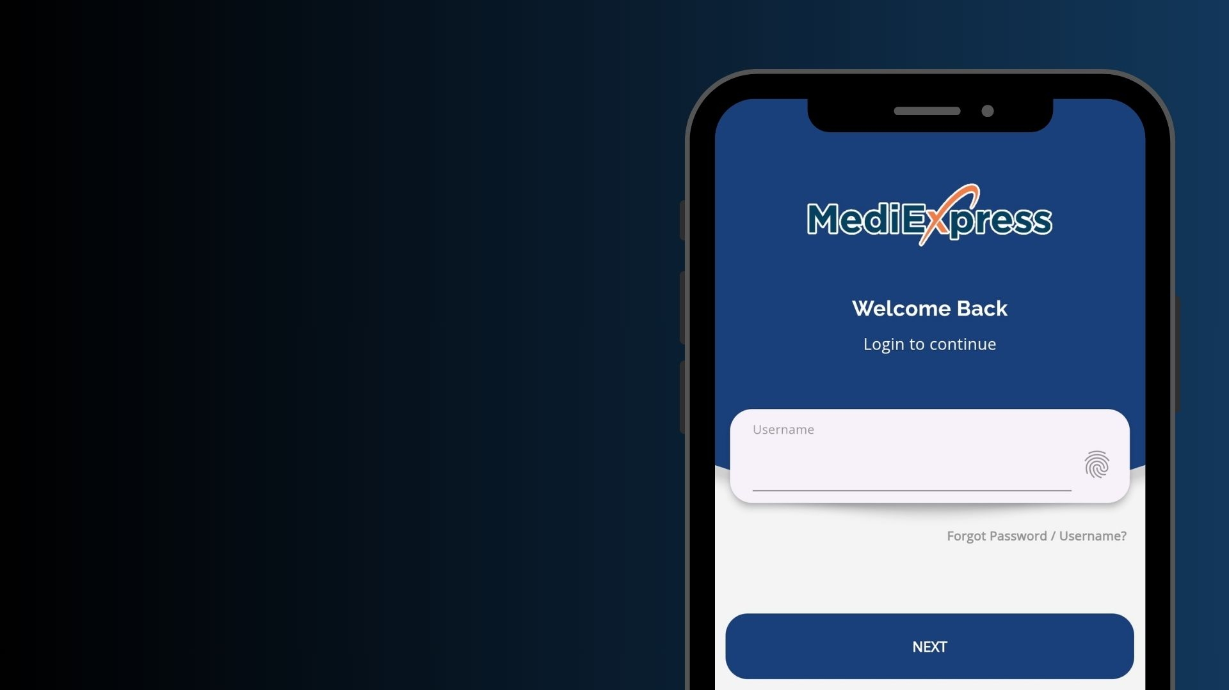

MOBILE APP
USER GUIDE
FOR MEMBERS
MEDIEXPRESS (MALAYSIA) SDN BHD
HEALTH CONNECT SDN BHD

Slide 2
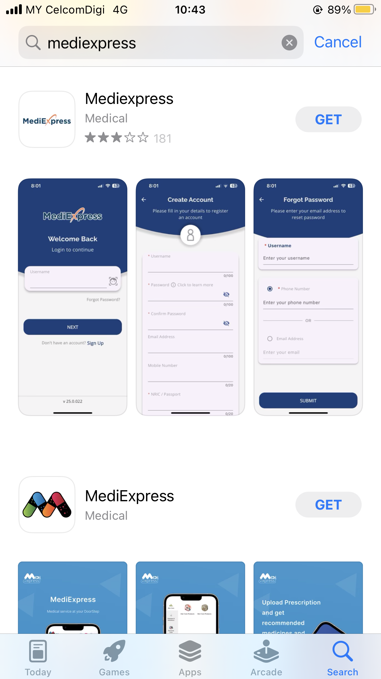





SCAN QR CODE TO INSTALL THE MOBILE APP
iOS User
Android User
iOS 17 & above
Android 13 & above
*If your phone doesn’t support the app, you can access it
through the web version.
https://m.mediexpress.com.my/login

Slide 3


MEDIEXPRESS – HEALTH CONNECT LOGO
“MediExpress”
for all inpatient / outpatient specialist treatments in
PANEL HOSPITAL
“Health Connect”
for outpatient treatments in PANEL GP CLINIC
Note: This logo is for recognition purposes only. Both services are still accessible through the MediExpress App

Slide 4

MEDIEXPRESS - HEALTHCARE APPLICATION
FEATURES AVAILABLE
Log In
Forgot Password
Biometric Login
Homepage Highlight Banner
e-Card
Notifications and Messages
Profile Update
Entitlement & Balance Limit
Claim Submission
Claim Status History
Guarantee Letter Status
Panel Locator
Wellness – Health Tracker
Search for “MediExpress”
iOS 17 & above | Android 13 & above

Slide 5

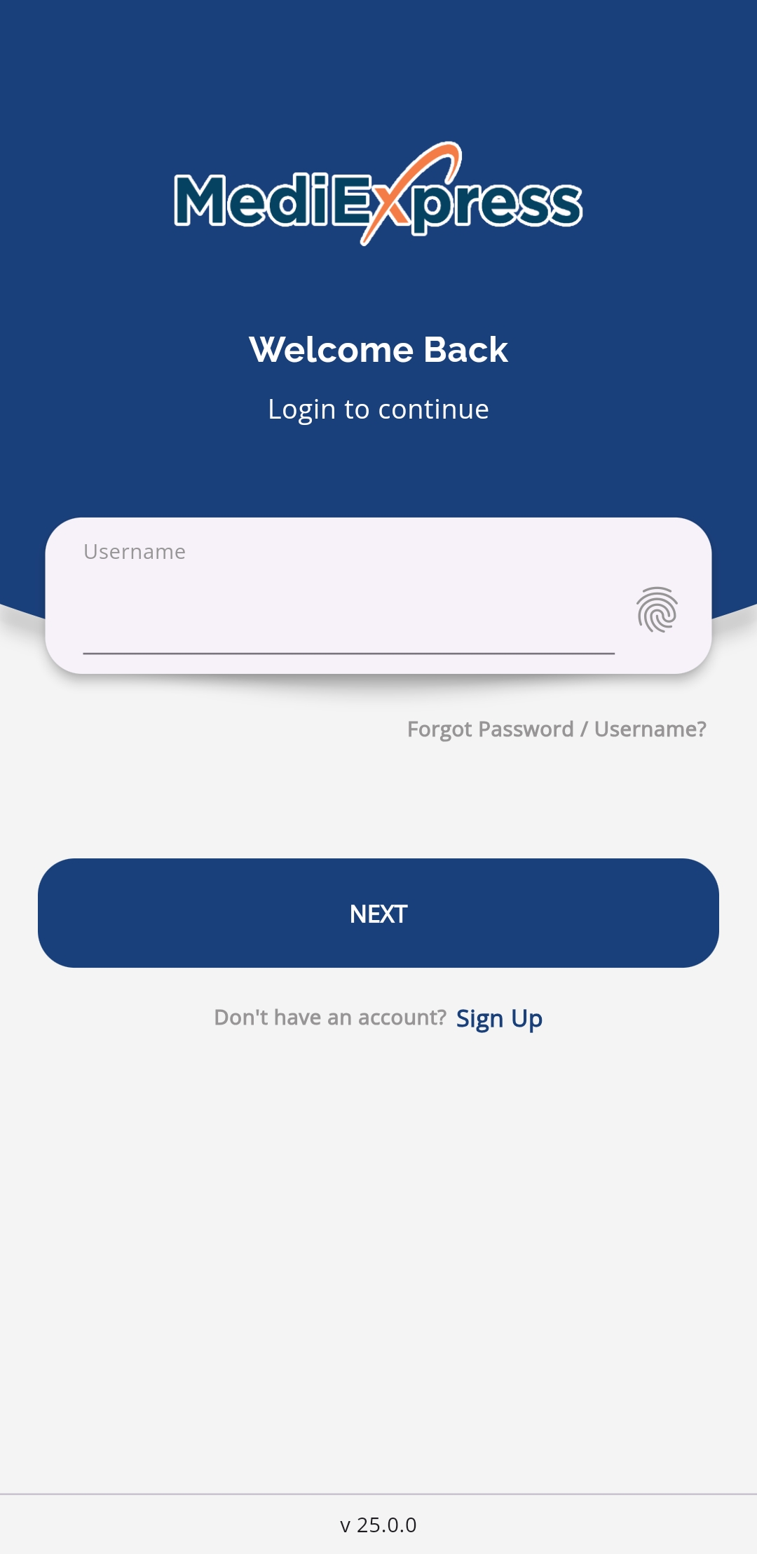
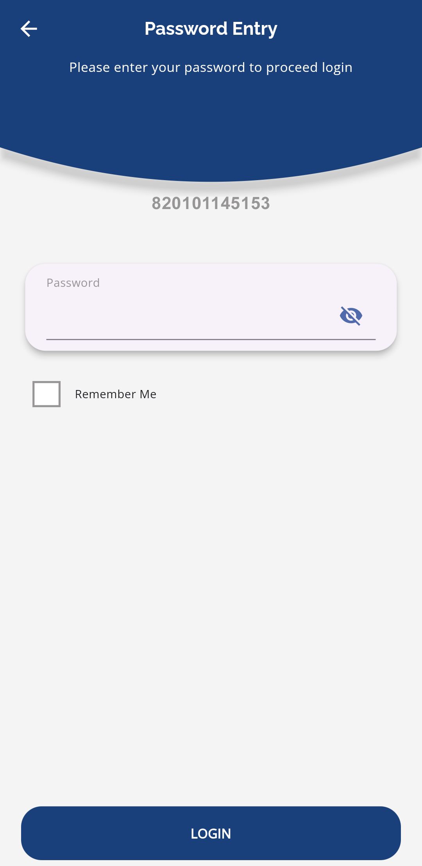
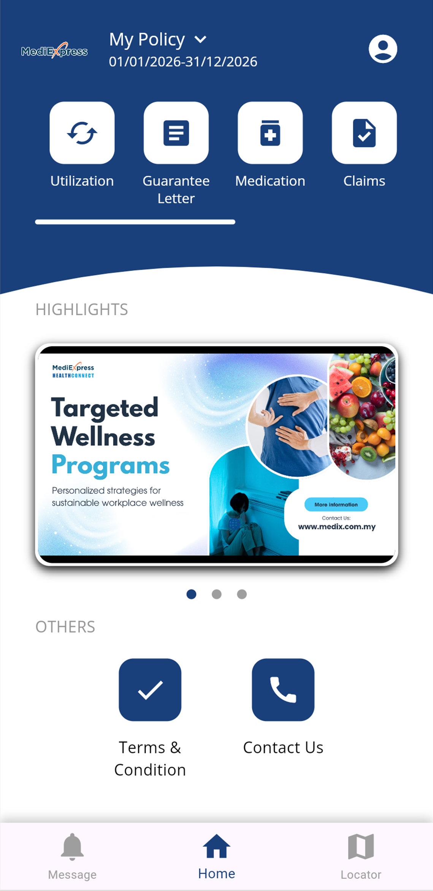

LOG IN
Login by enter username and tap NEXT button
Enter password and LOGIN
The password is user birthdate number without dash.
Example:
IC: 900101145678
Password: 01011990 (dd/mm/yyyy format)
After login, user will redirect to homepage

Slide 6
FORGOT PASSWORD
Select Forgot Password/Username
Enter email address to reset password or retrieve username and SUBMIT
User will receive notification email to change password and retry the login process

Slide 7
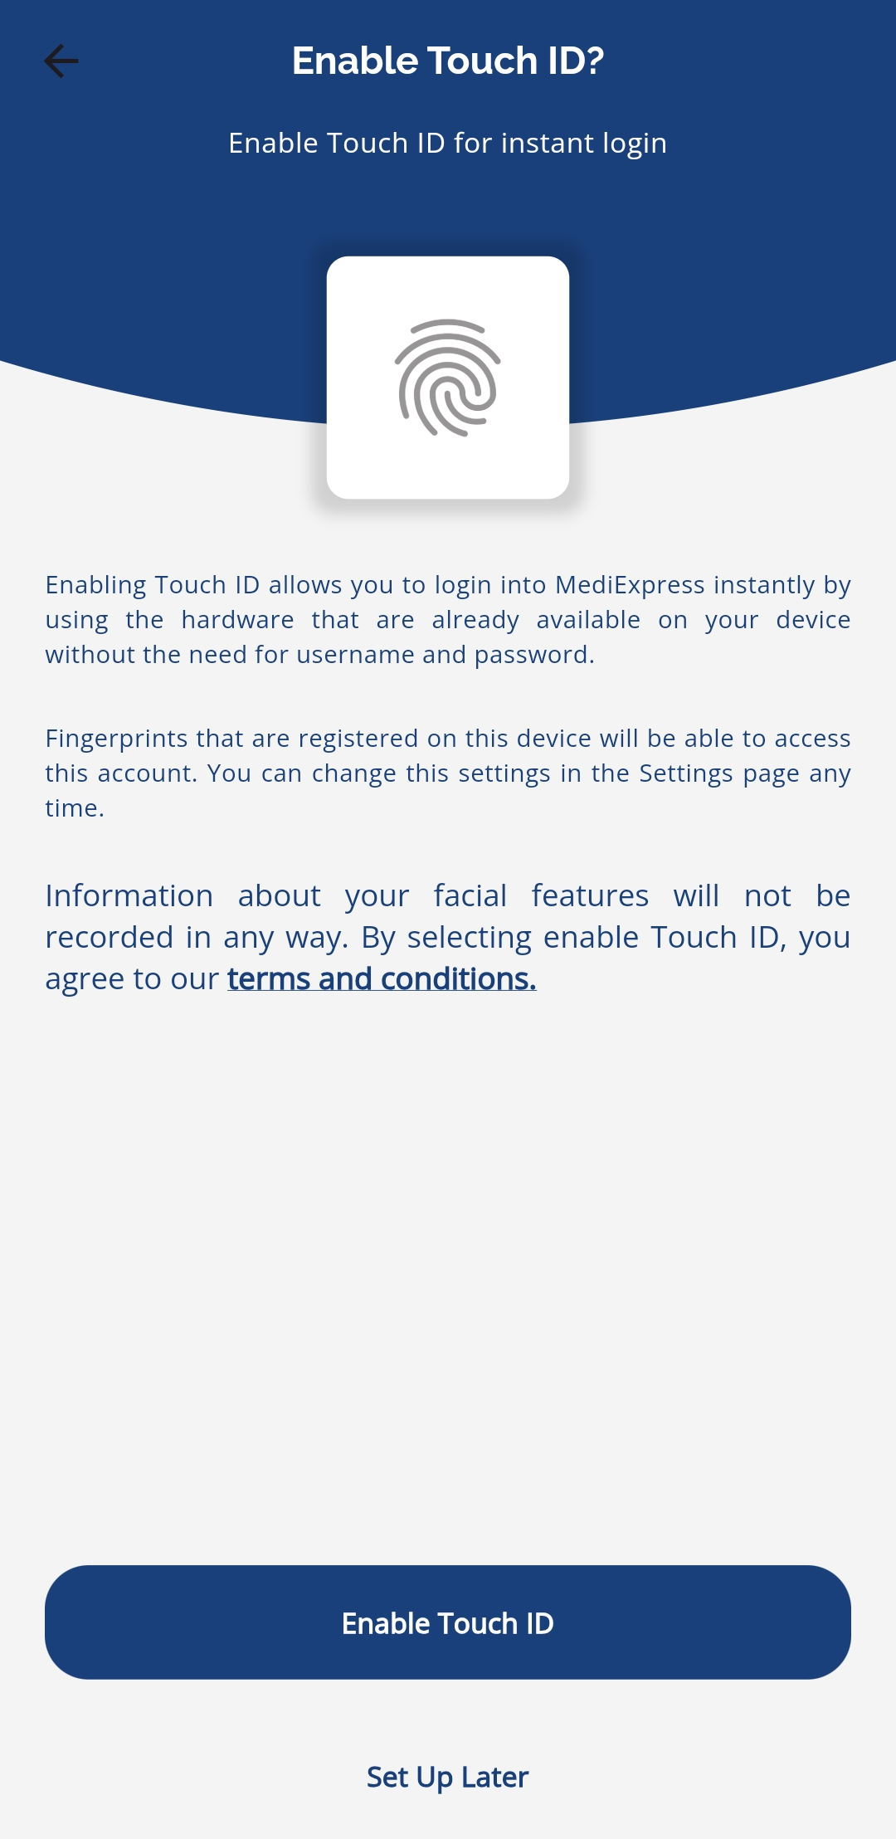
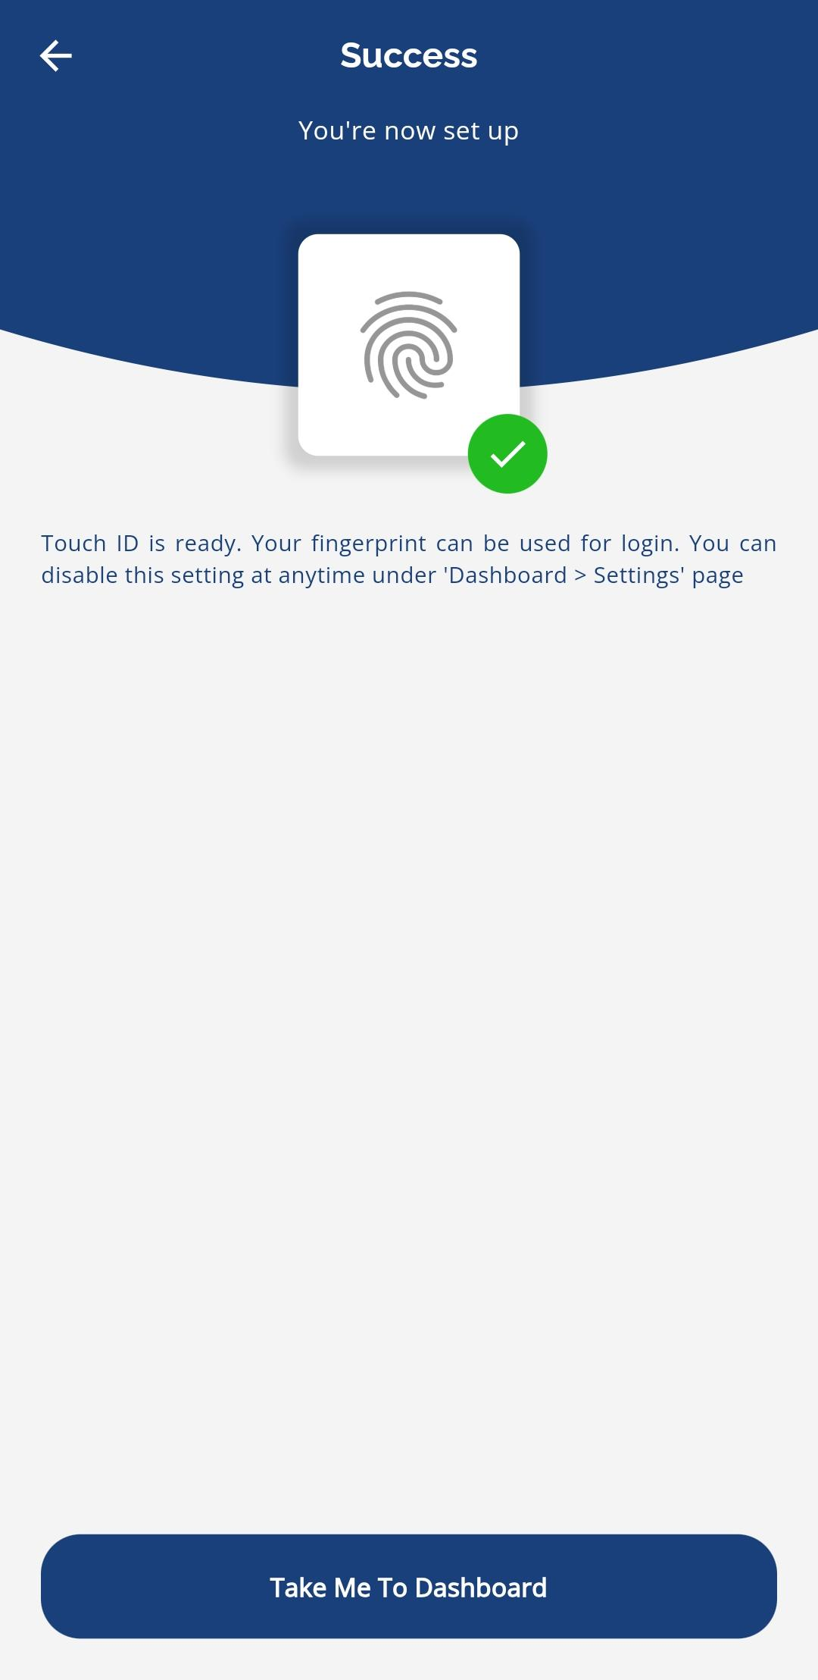
BIOMETRIC LOGIN
Tap the fingerprint icon to enable biometric login
Select Enable Touch ID to set up the biometric login
Once successful, user will redirect to homepage

Slide 8
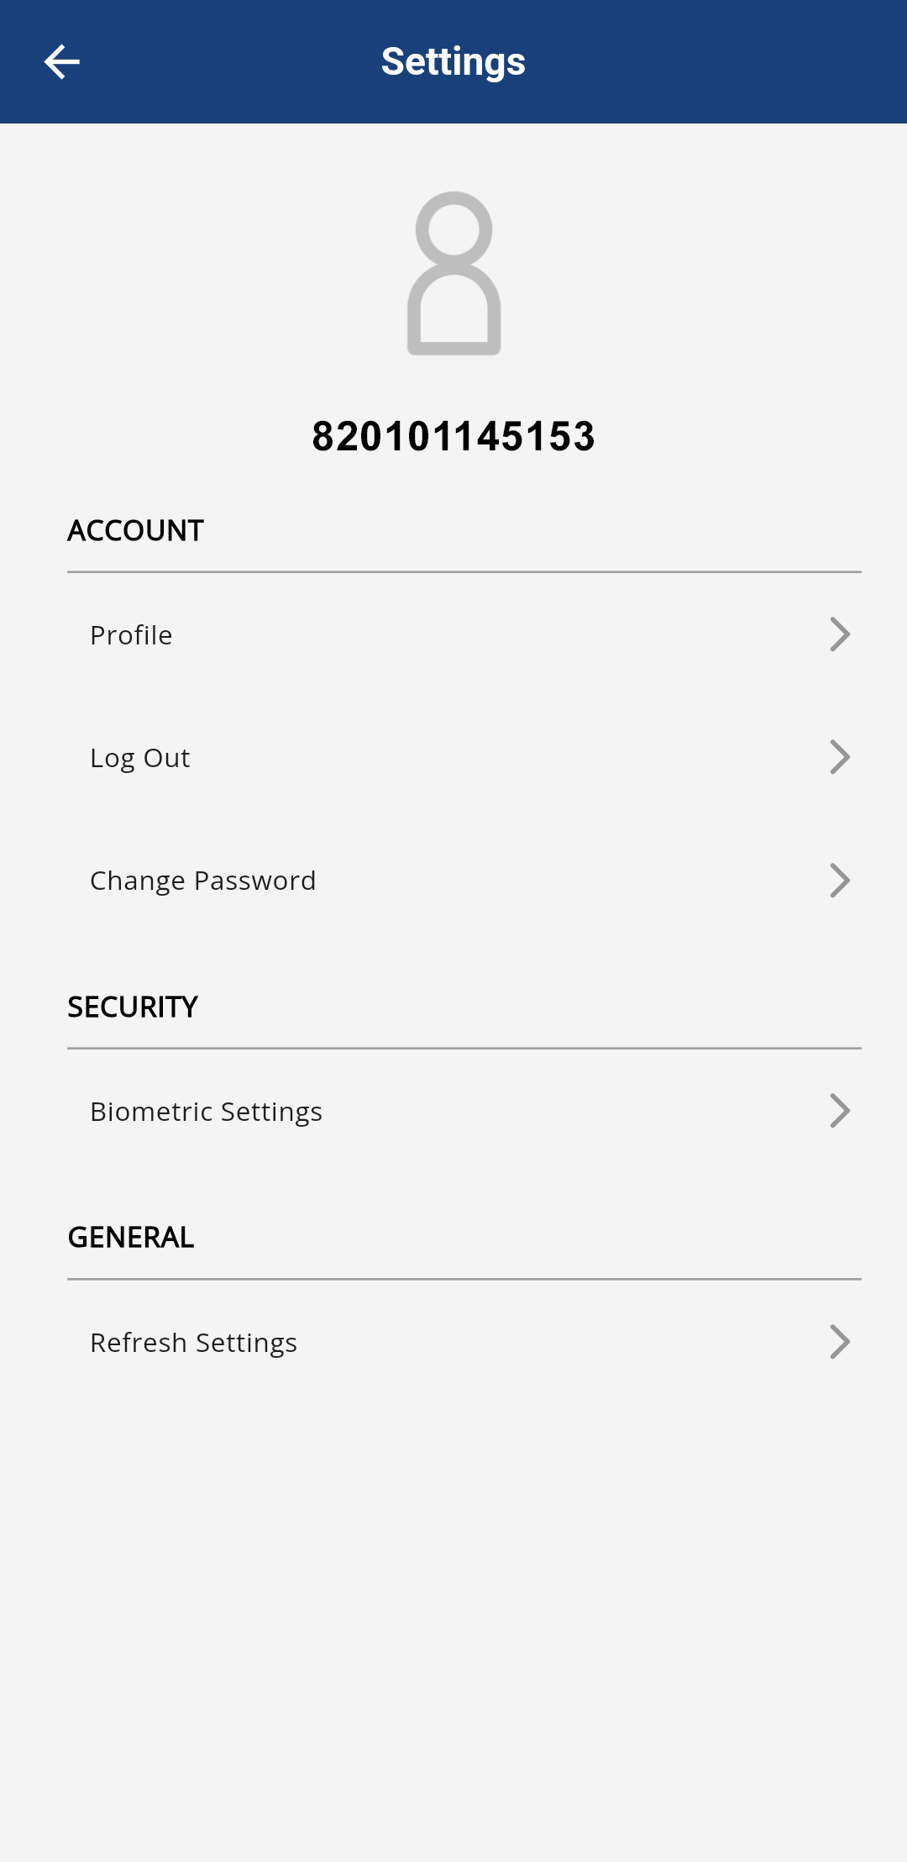
ENABLE / DISABLE BIOMETRIC LOGIN
Tap the profile icon at the top of the screen to open Settings
Select Biometric Settings to enable or disable the biometric login

Slide 9


HOMEPAGE HIGHLIGHT BANNER
Samples of highlight banner
The homepage highlight banner showcases important updates and information
Tap the banner to read the full article

Slide 10
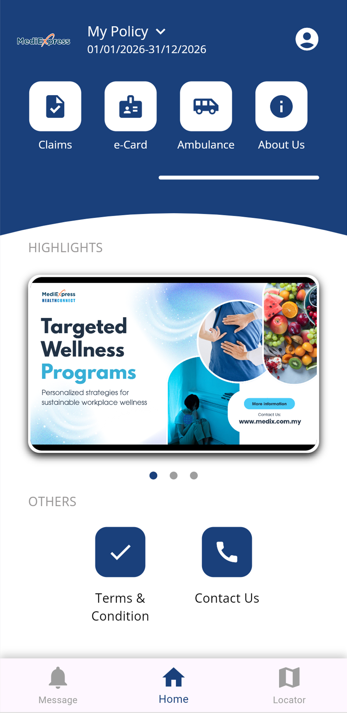
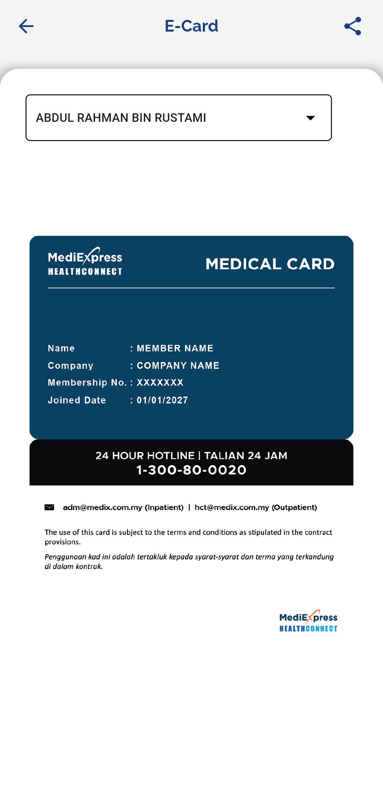
E-CARD
Go to homepage
Swipe left on the top
Tap the e-Card icon
The e-card will be displayed on the screen
Select dropdown to view other members’ e-cards
Select the share icon to save or share the e-card

Slide 11
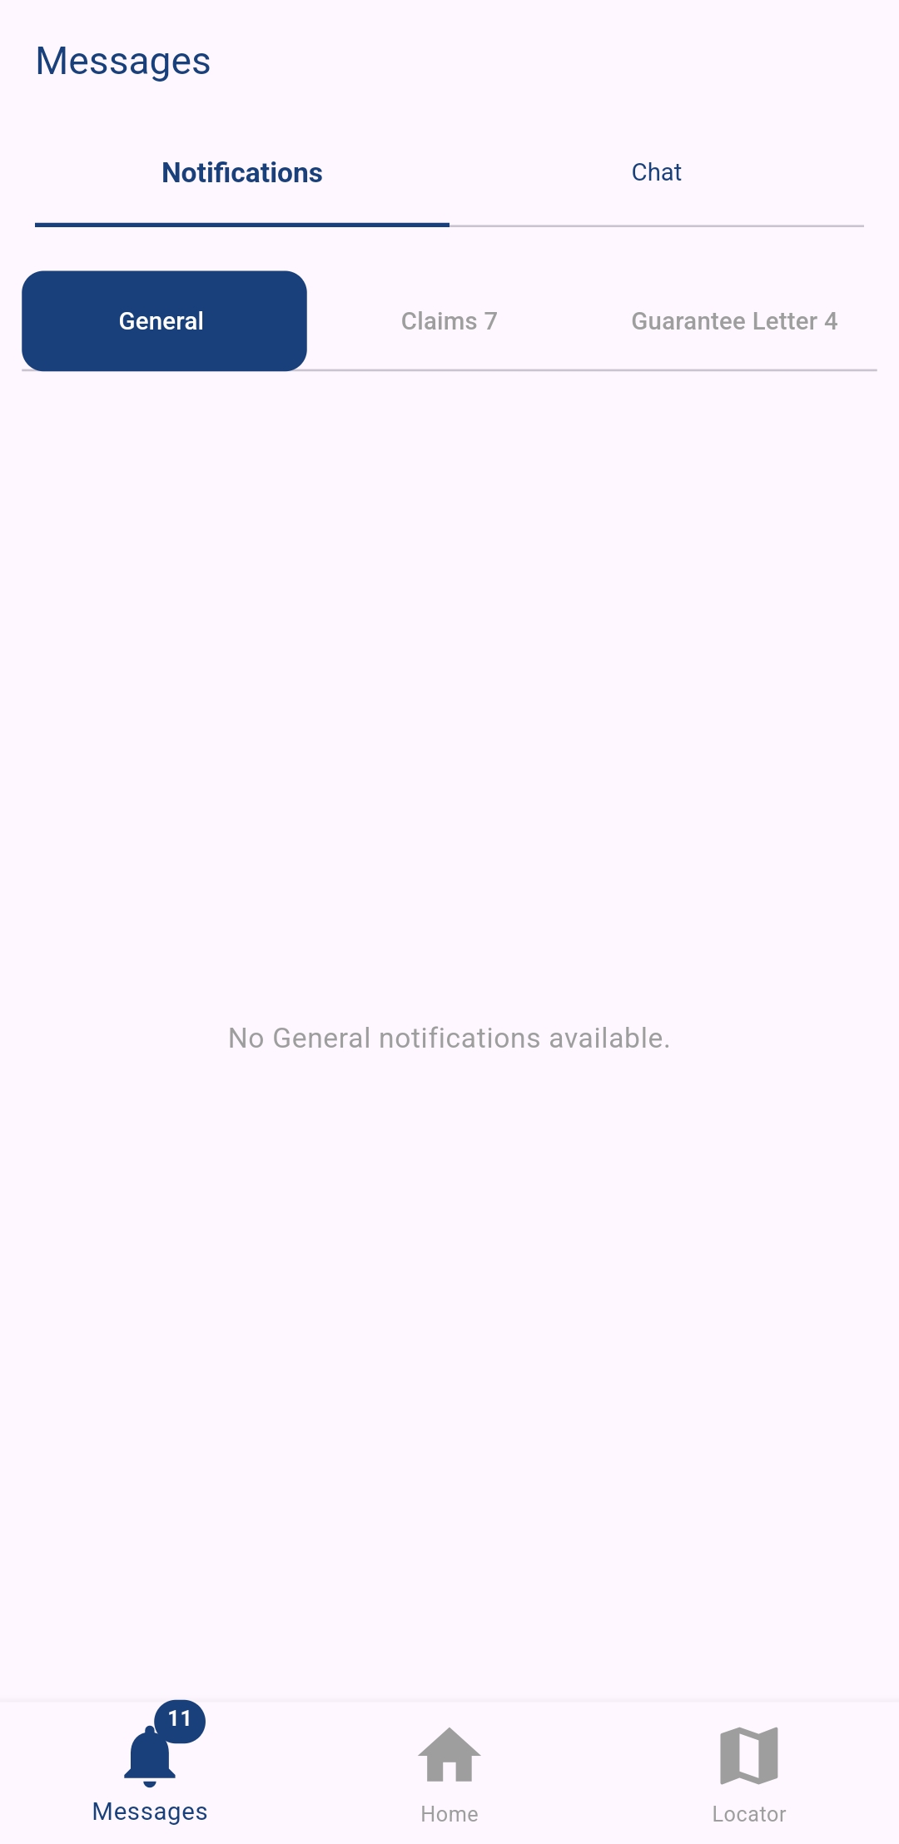
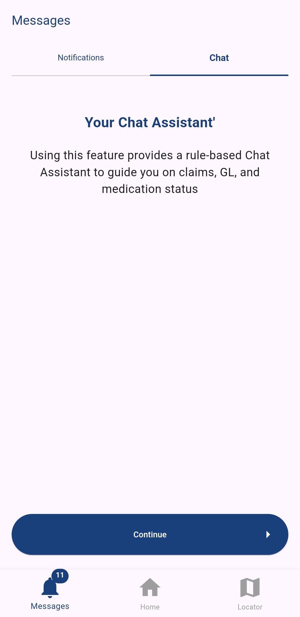
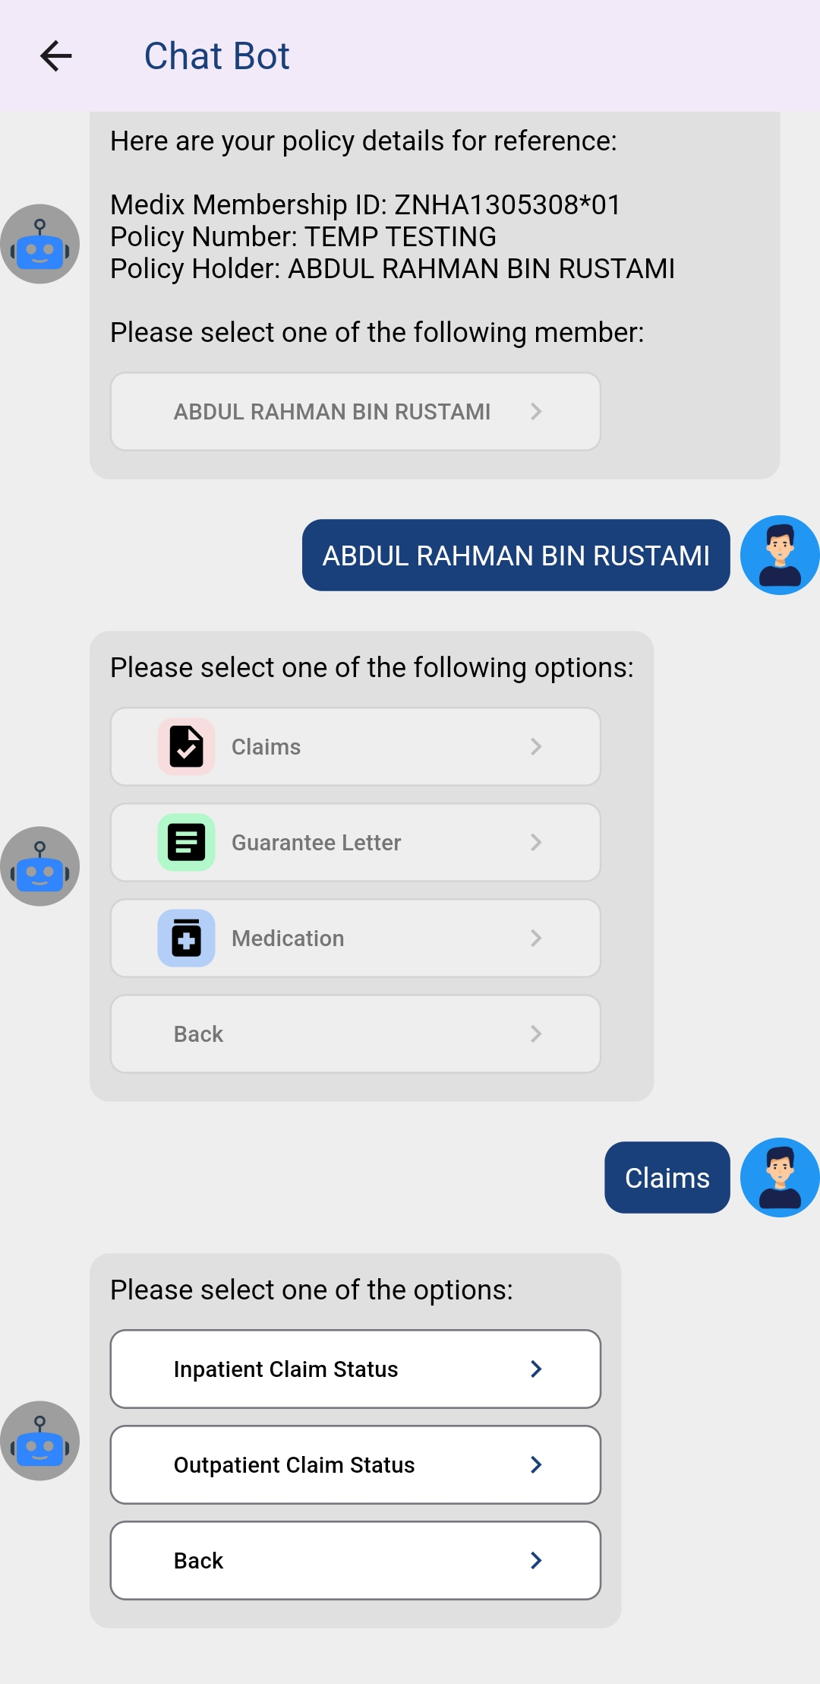
NOTIFICATIONS & MESSAGES
Go to homepage
Tap Messages
Tap Notifications
Select General, Claims or Guarantee Letter to view the latest updates
User will receive real-time notifications on claim utilization
Tap Chat to message the automated assistant
Check your claim utilization status by selecting the available options in the chat

Slide 12
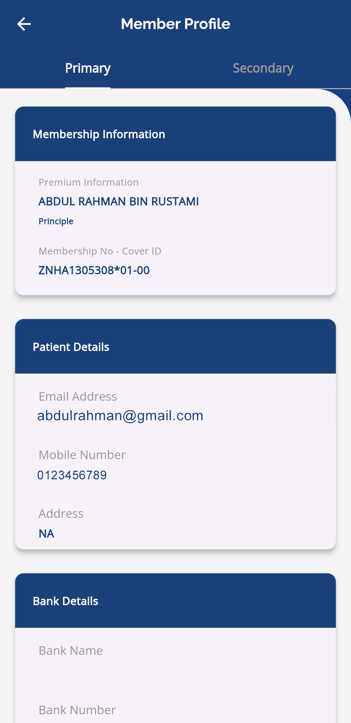
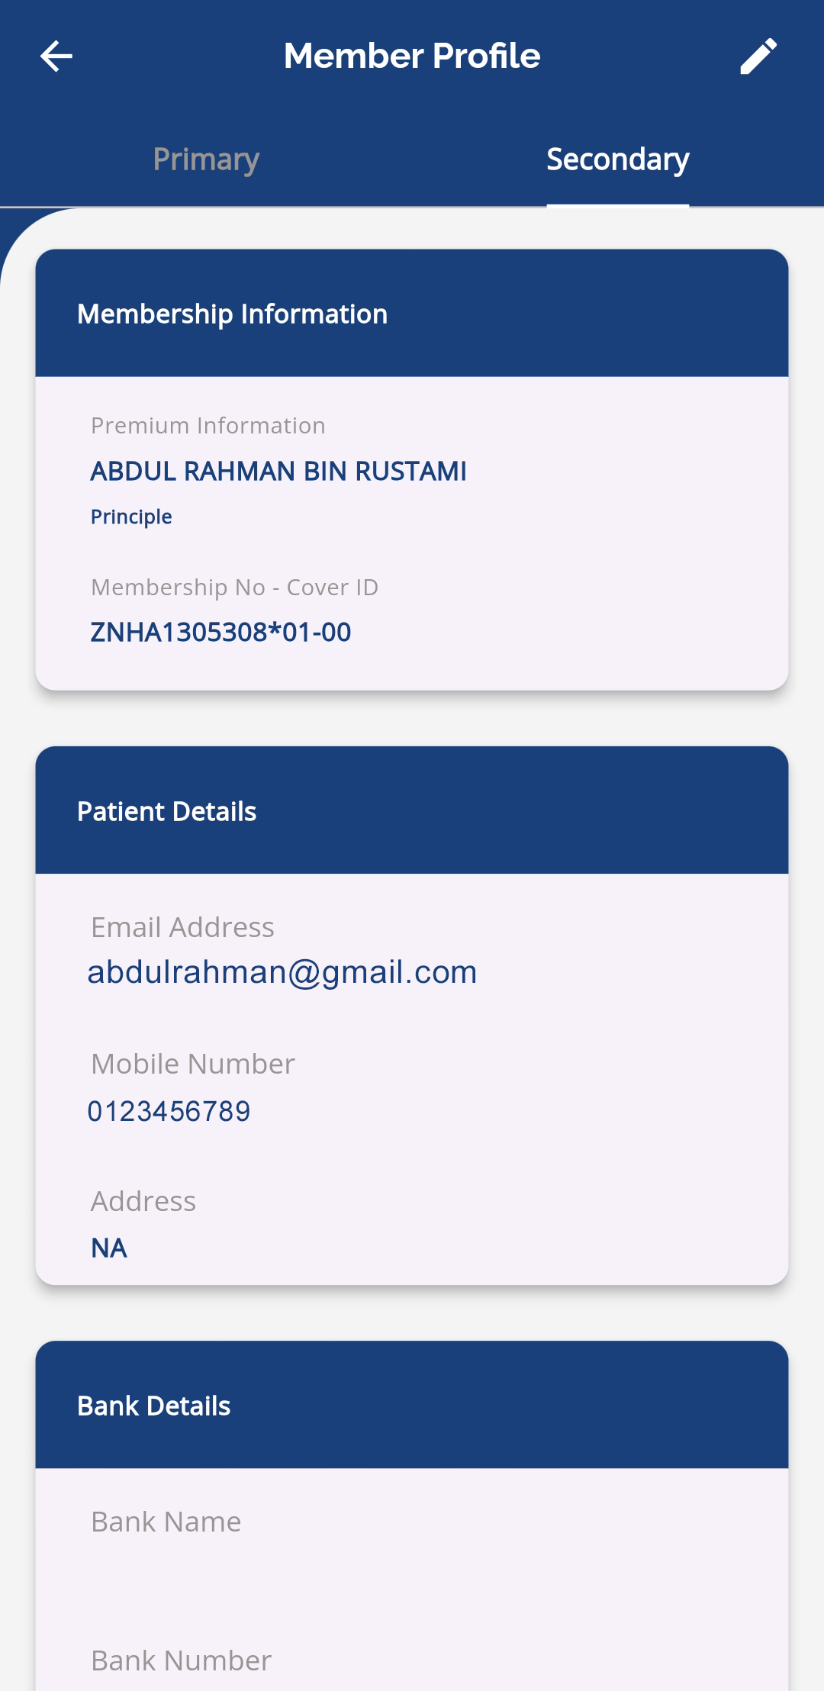
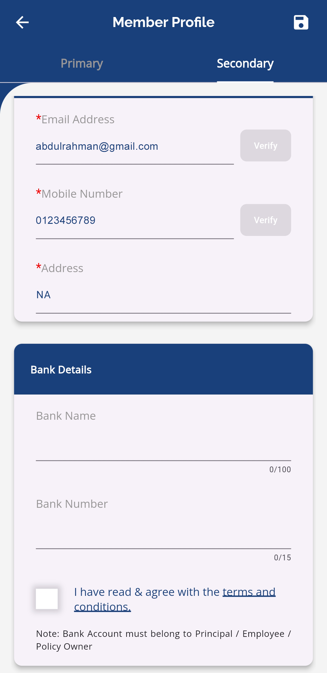
PROFILE UPDATE
Go to homepage
Tap the profile icon at the top of the screen to open Profile Settings
In Primary, you can view your current profile
Tap Secondary to update your profile
Tap the pen icon at the top right to update profile details
Tap save icon to save the update

Slide 13
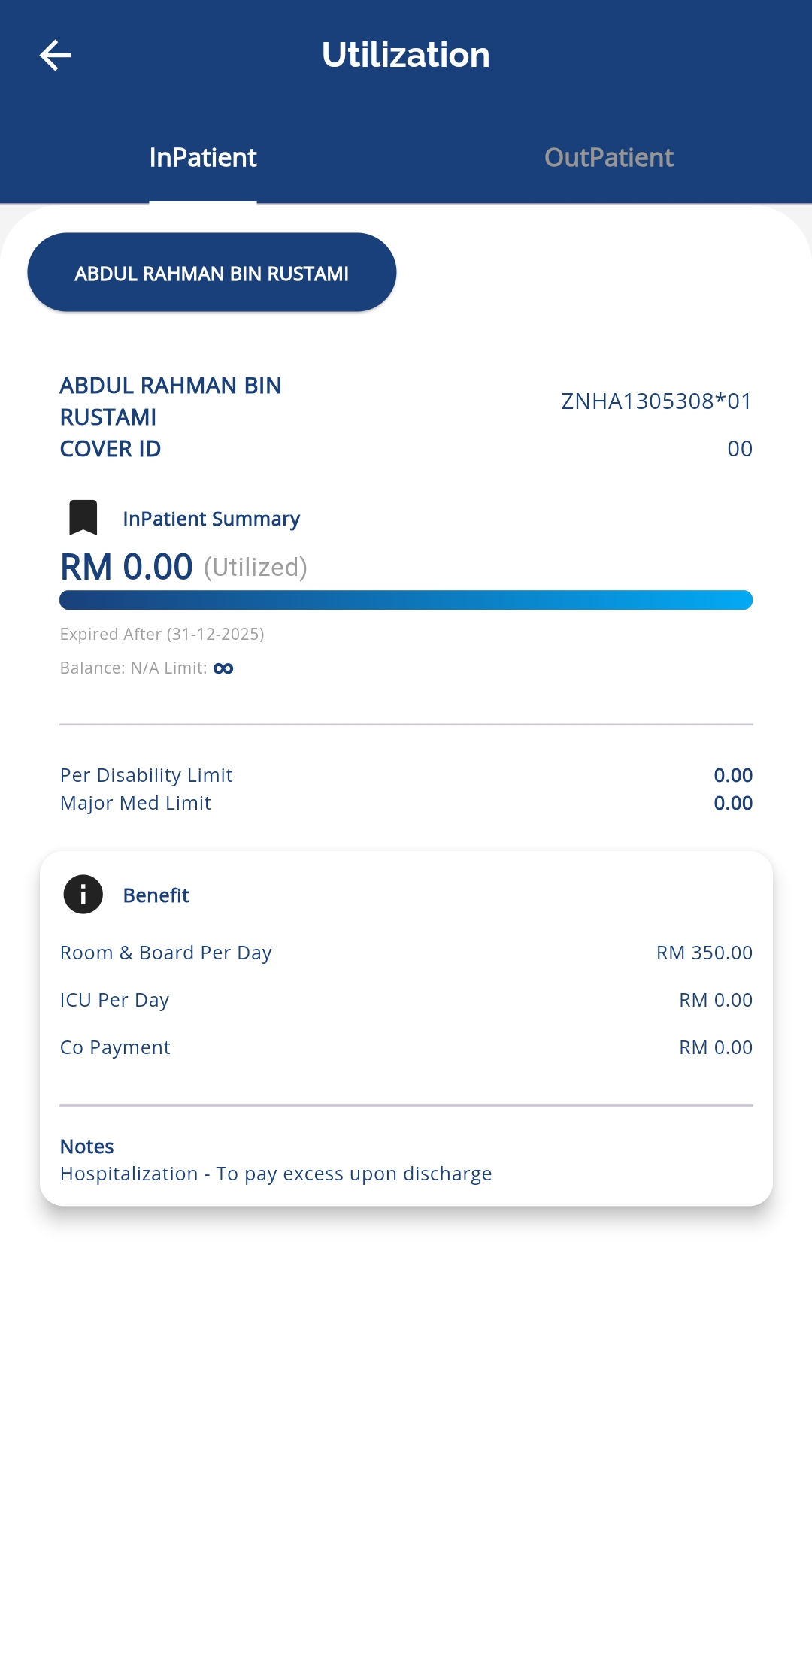
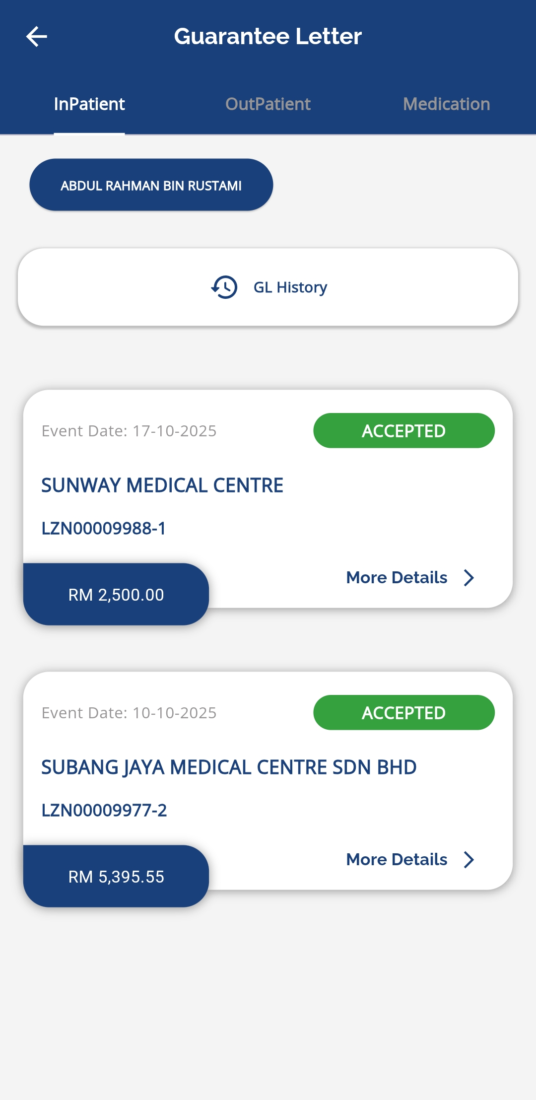
VIEW ENTITLEMENT & BALANCE LIMIT
Go to homepage
Tap Utilization
Click benefit type to view entitlement – Inpatient
User can view the entitlement of the family members by tapping their respective buttons

Slide 14
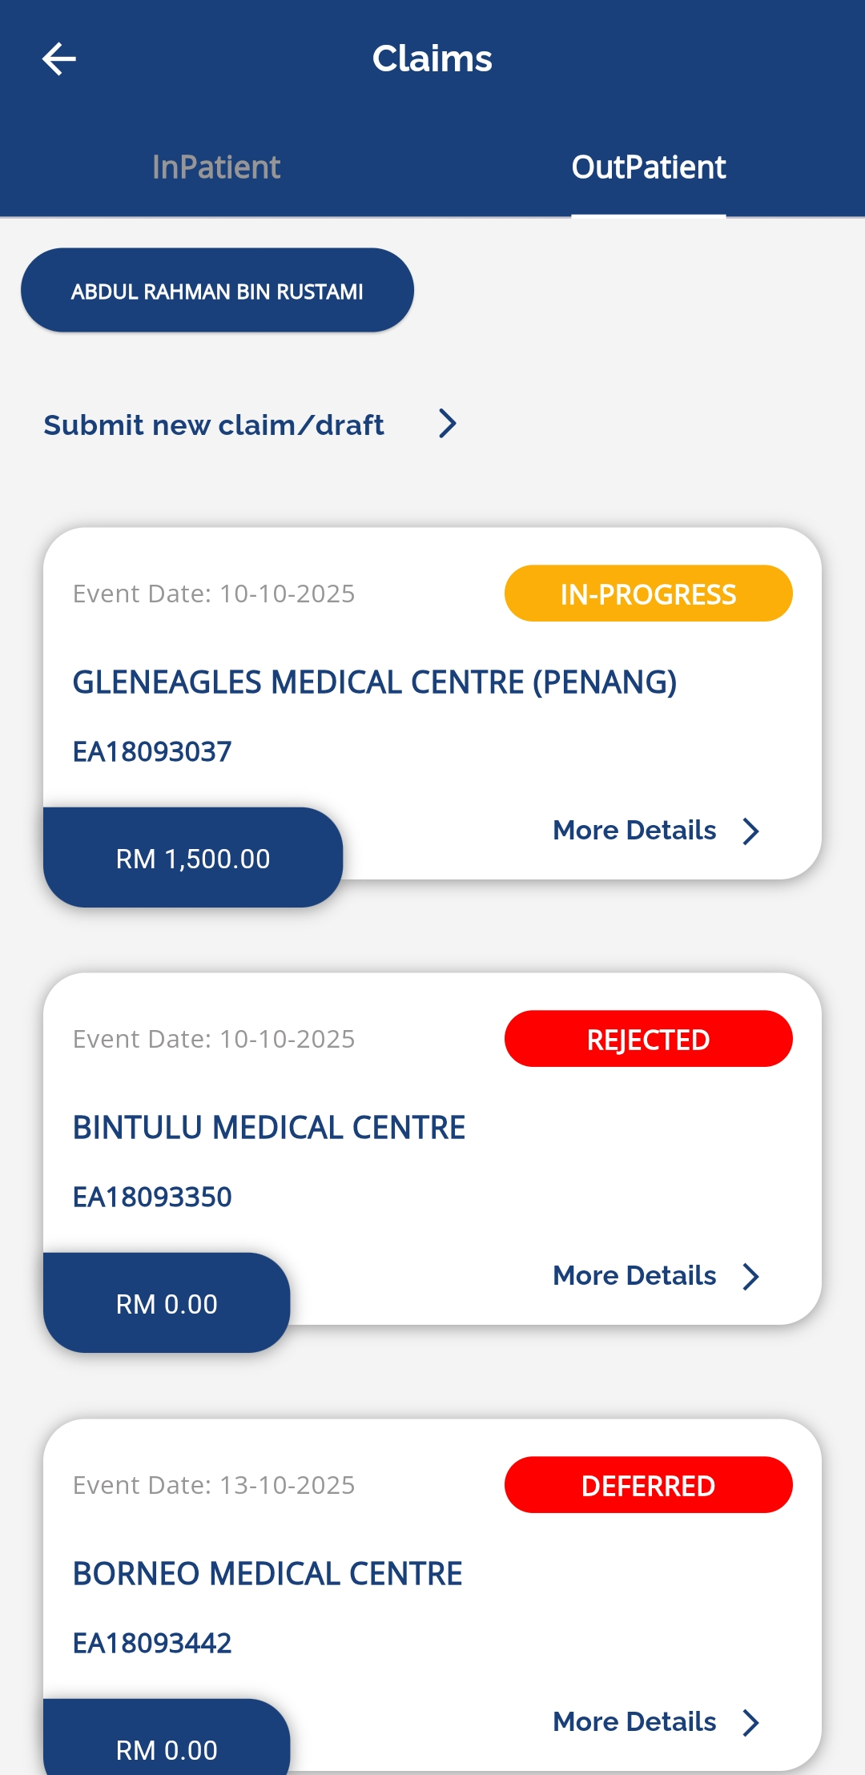
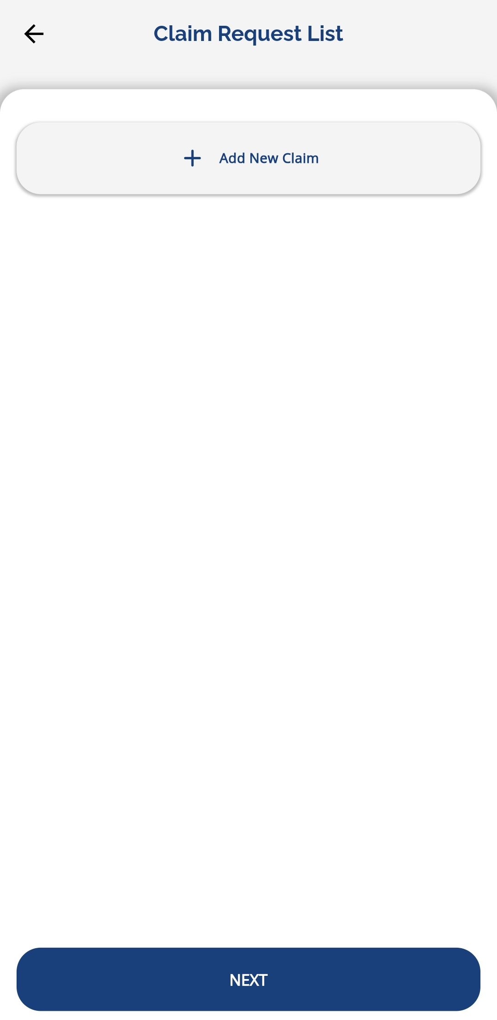
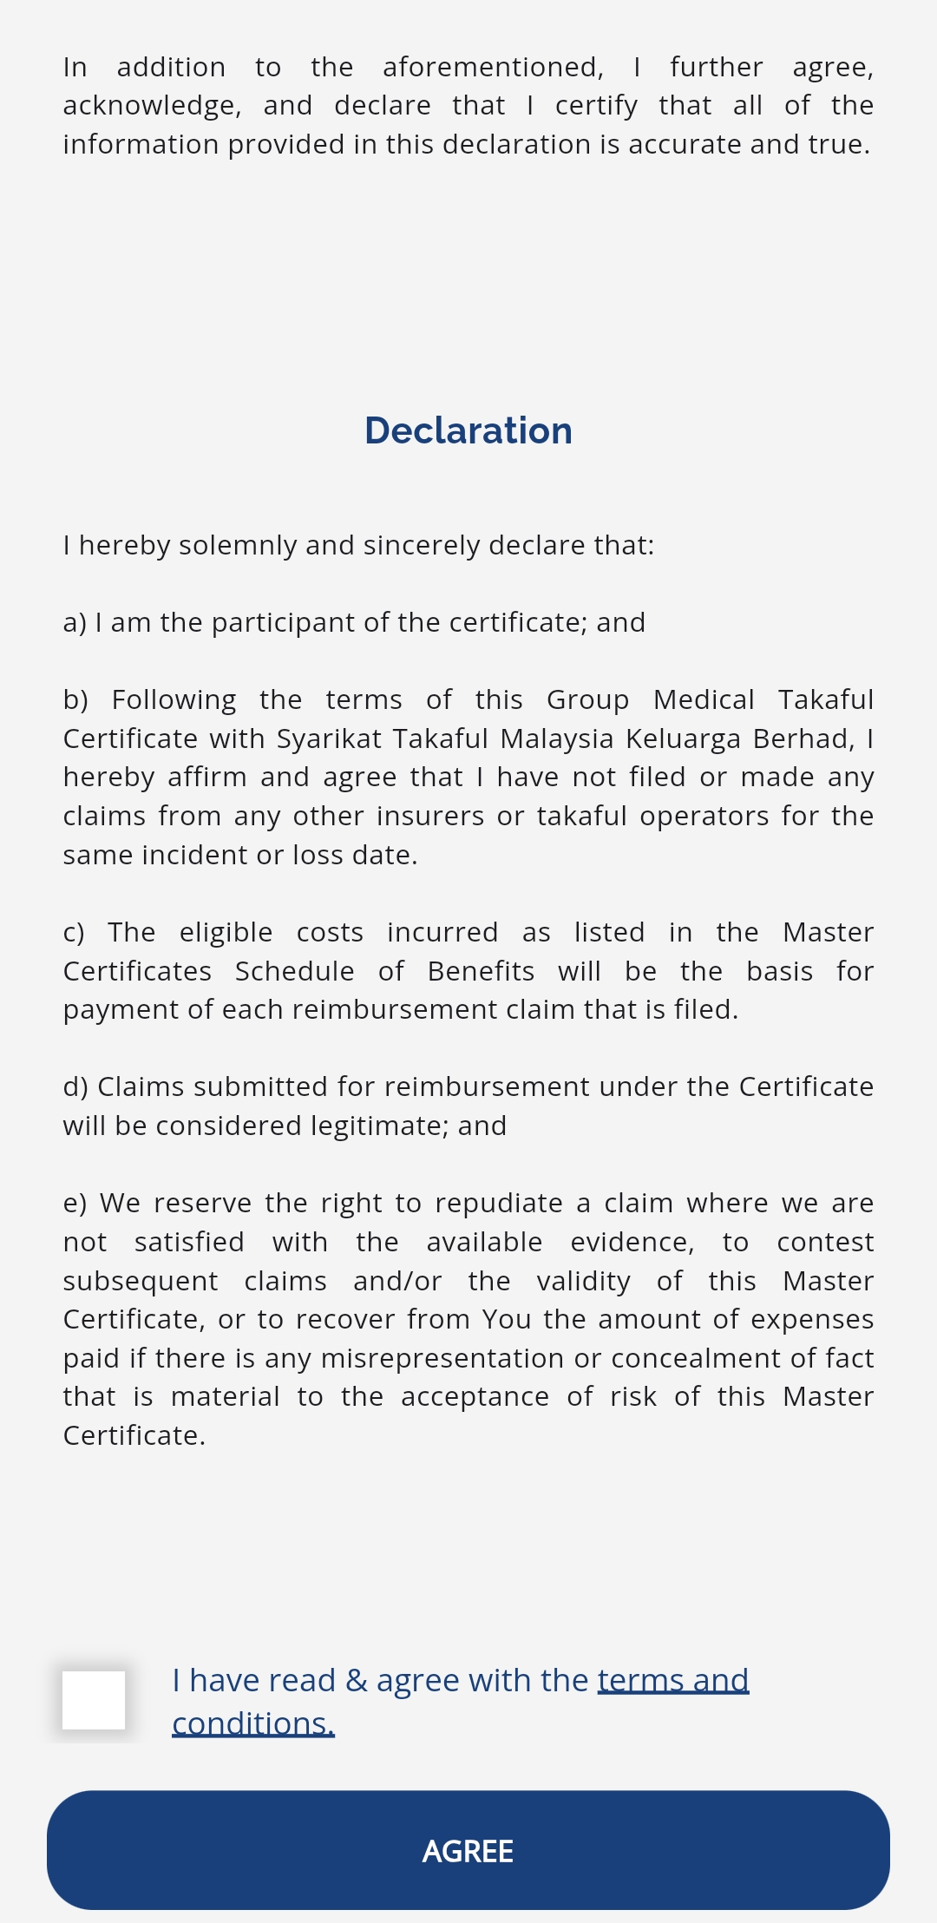
SUBMIT NEW CLAIM
Go to homepage
Tap Claims
Select claims type – Inpatient
Tap Submit New Claim
Tap Add New Claim
Tick the terms and conditions after reading the declaration
Tap Agree to proceed

Slide 15
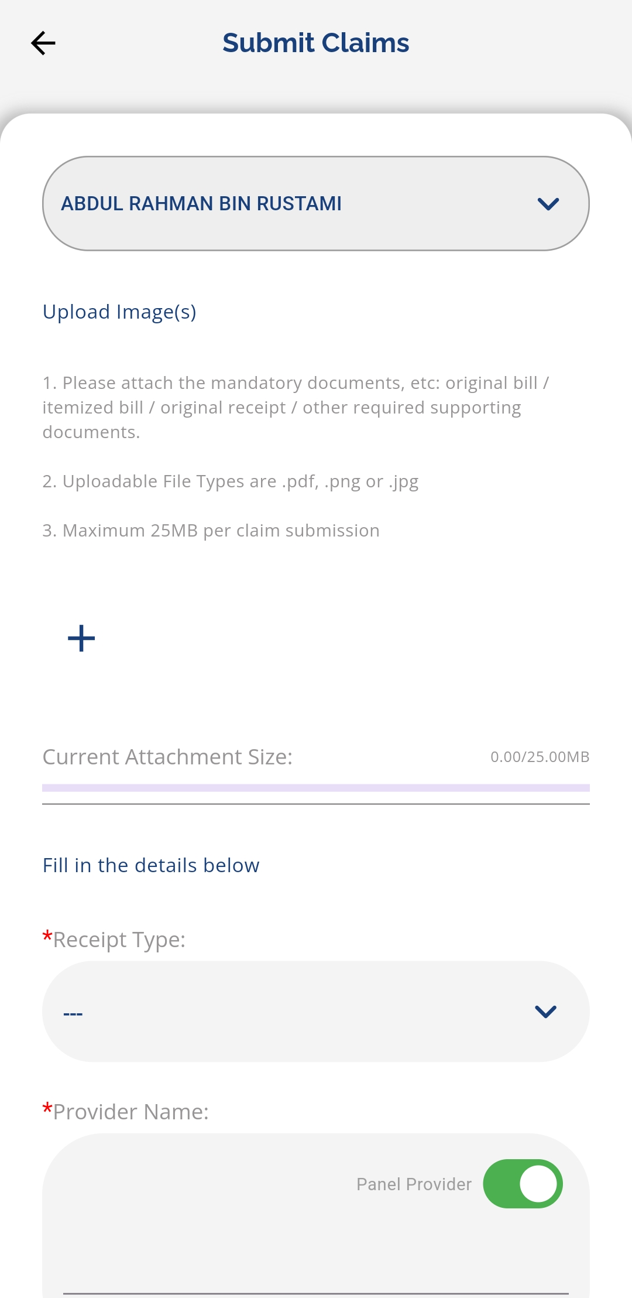
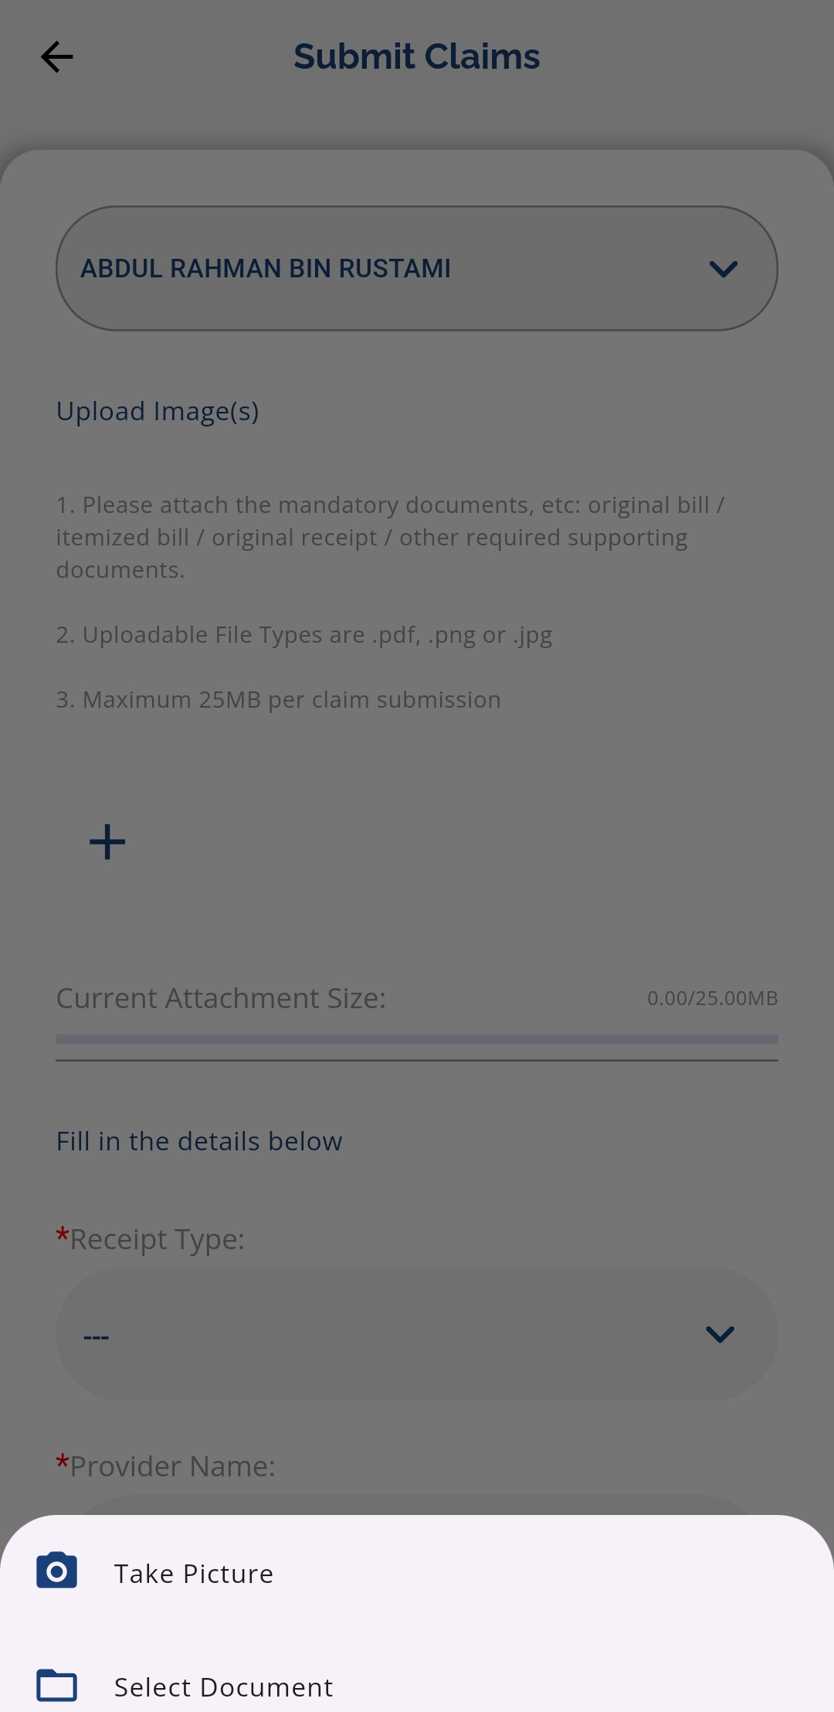
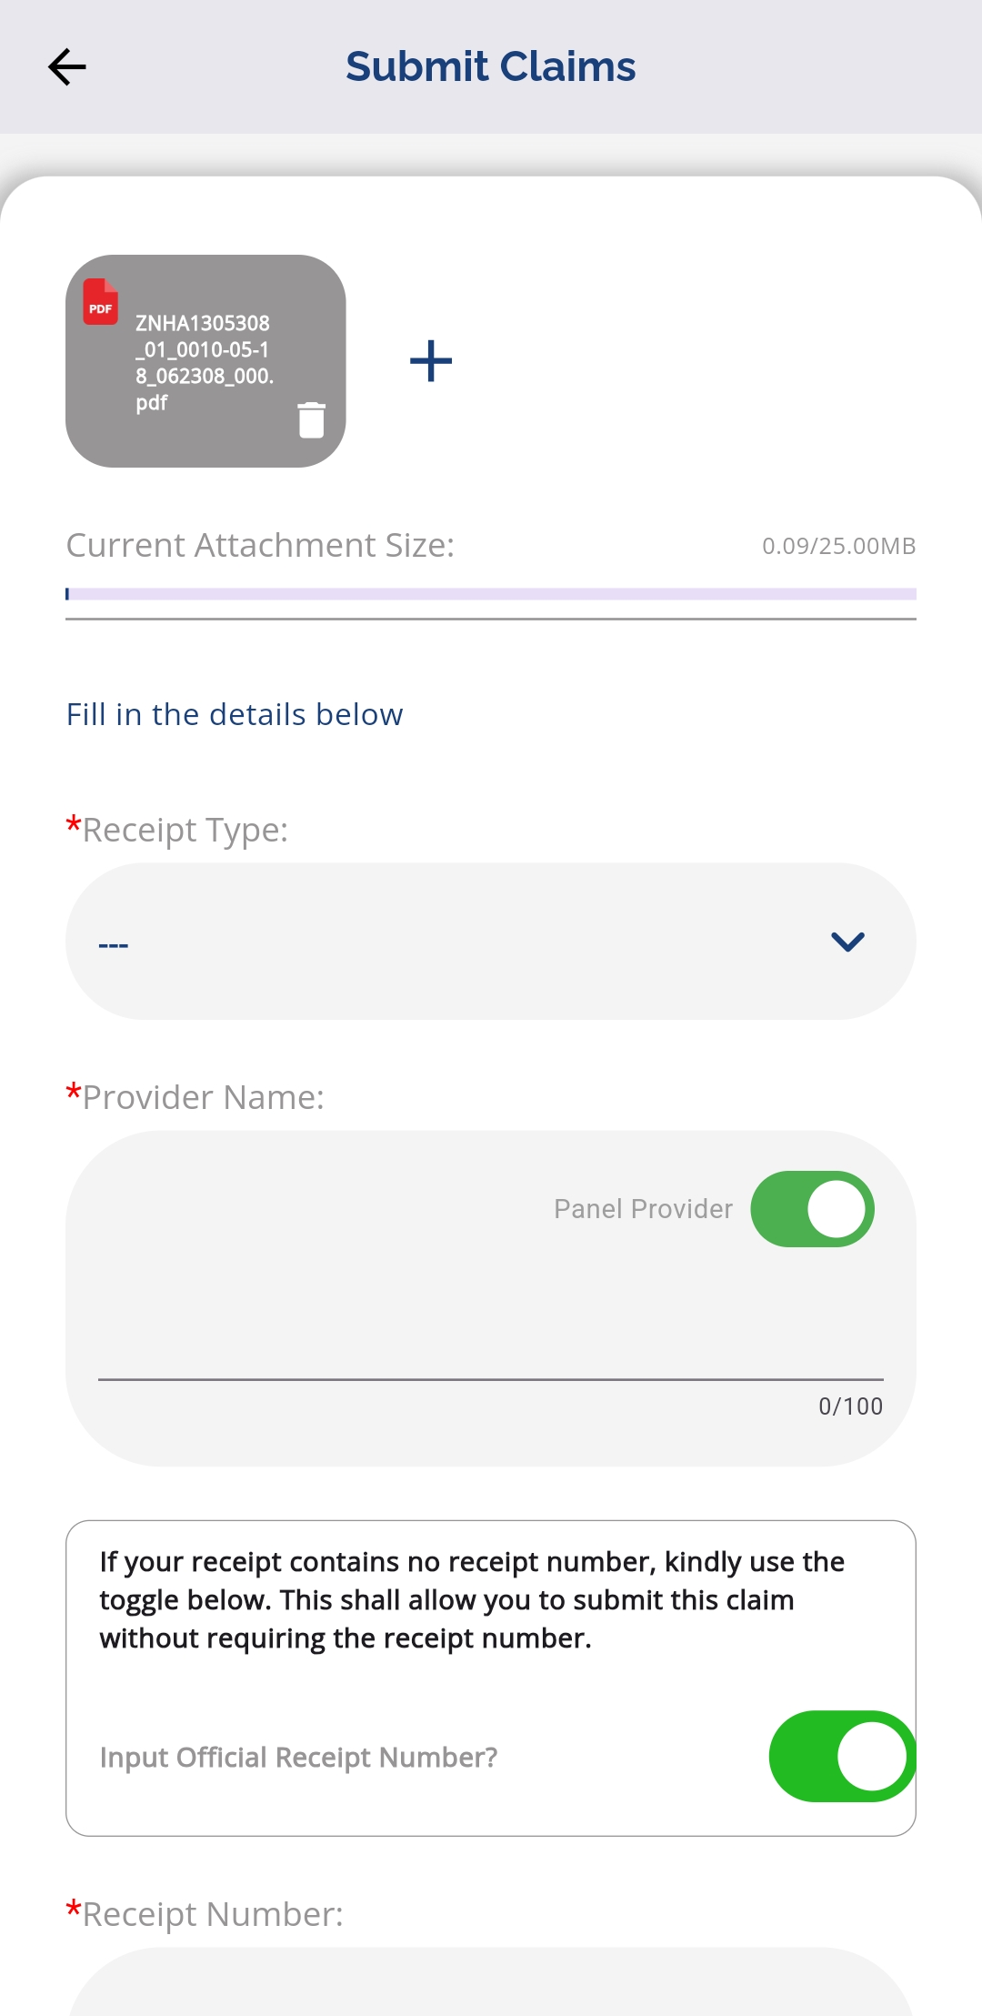
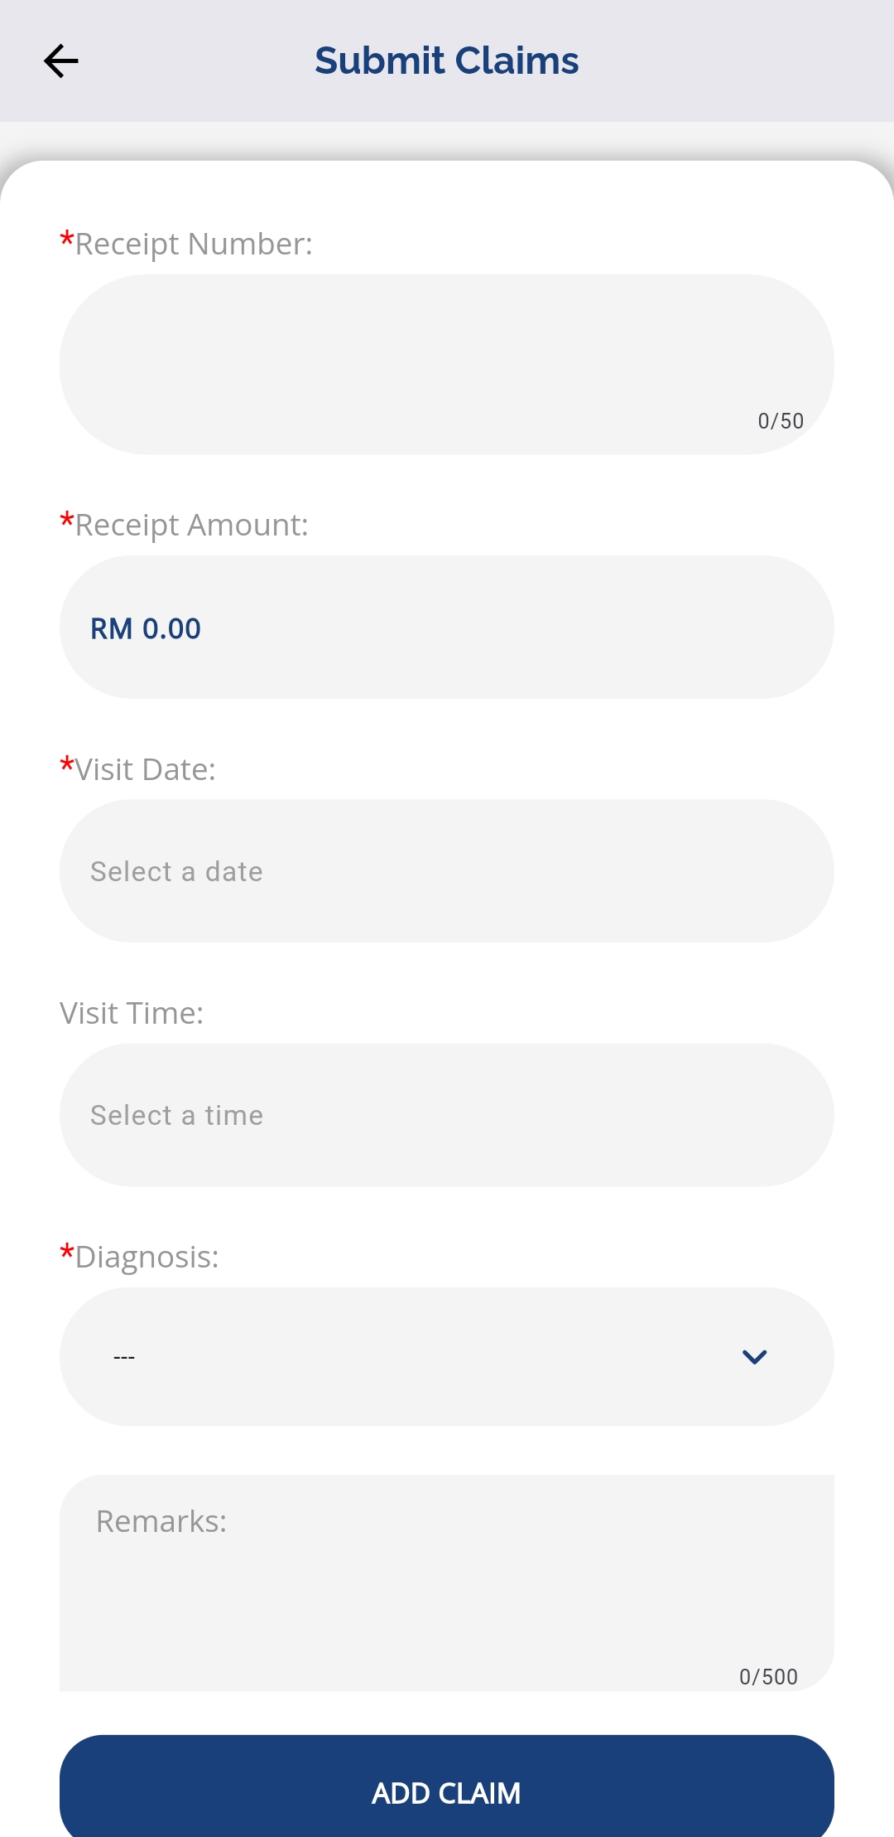
SUBMIT NEW CLAIM - CONTINUE
Tap the + icon to upload a receipt or invoice
Choose Take Picture to capture a photo or Select Document to upload file
Fill up all the required information
Tap ADD CLAIM to submit
Once submitted, the claim status will appear in the list

Slide 16
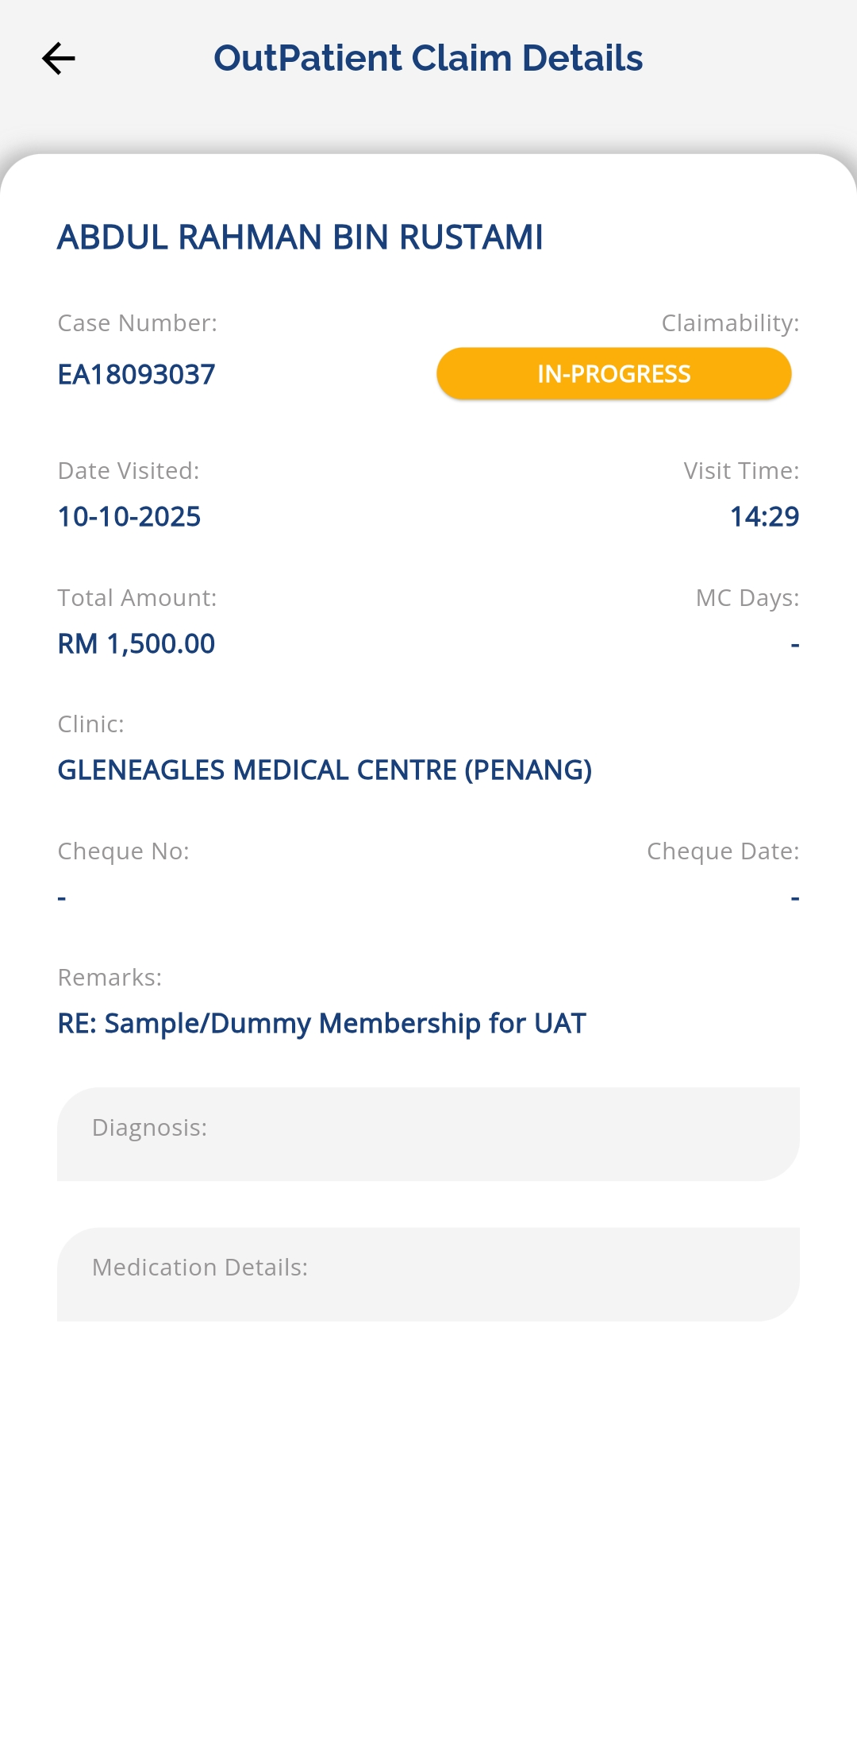
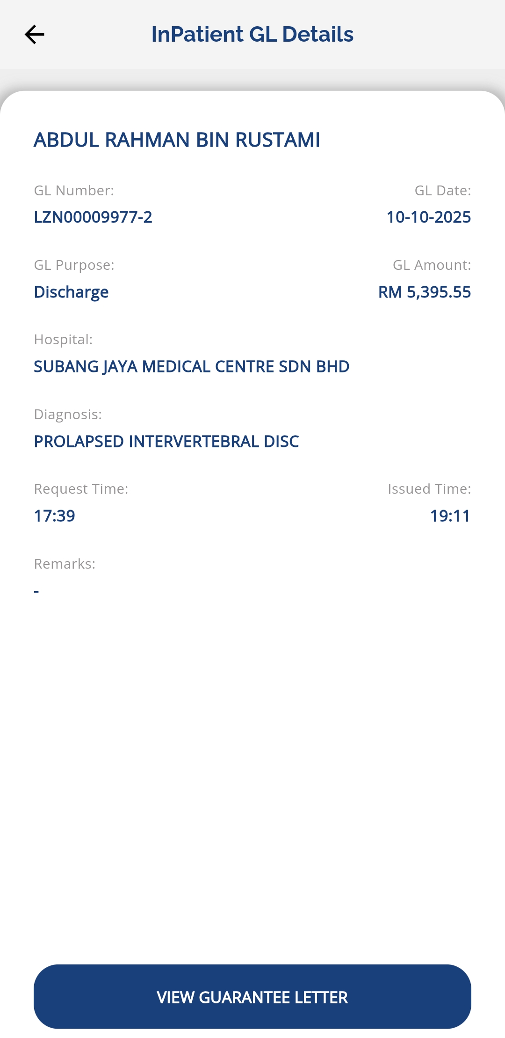
CLAIM STATUS HISTORY
Claim Status:
Accepted – The claim has been approved by Medix
Rejected – The claim was received but has been rejected
Deferred – The claim information is incomplete
In progress – The claim has been received and is under review
If the claim has been processed or concluded, more information will be displayed here.
Go to homepage
Tap Claims
Select claims type –
Inpatient
Tap More Details
View claim details

Slide 17
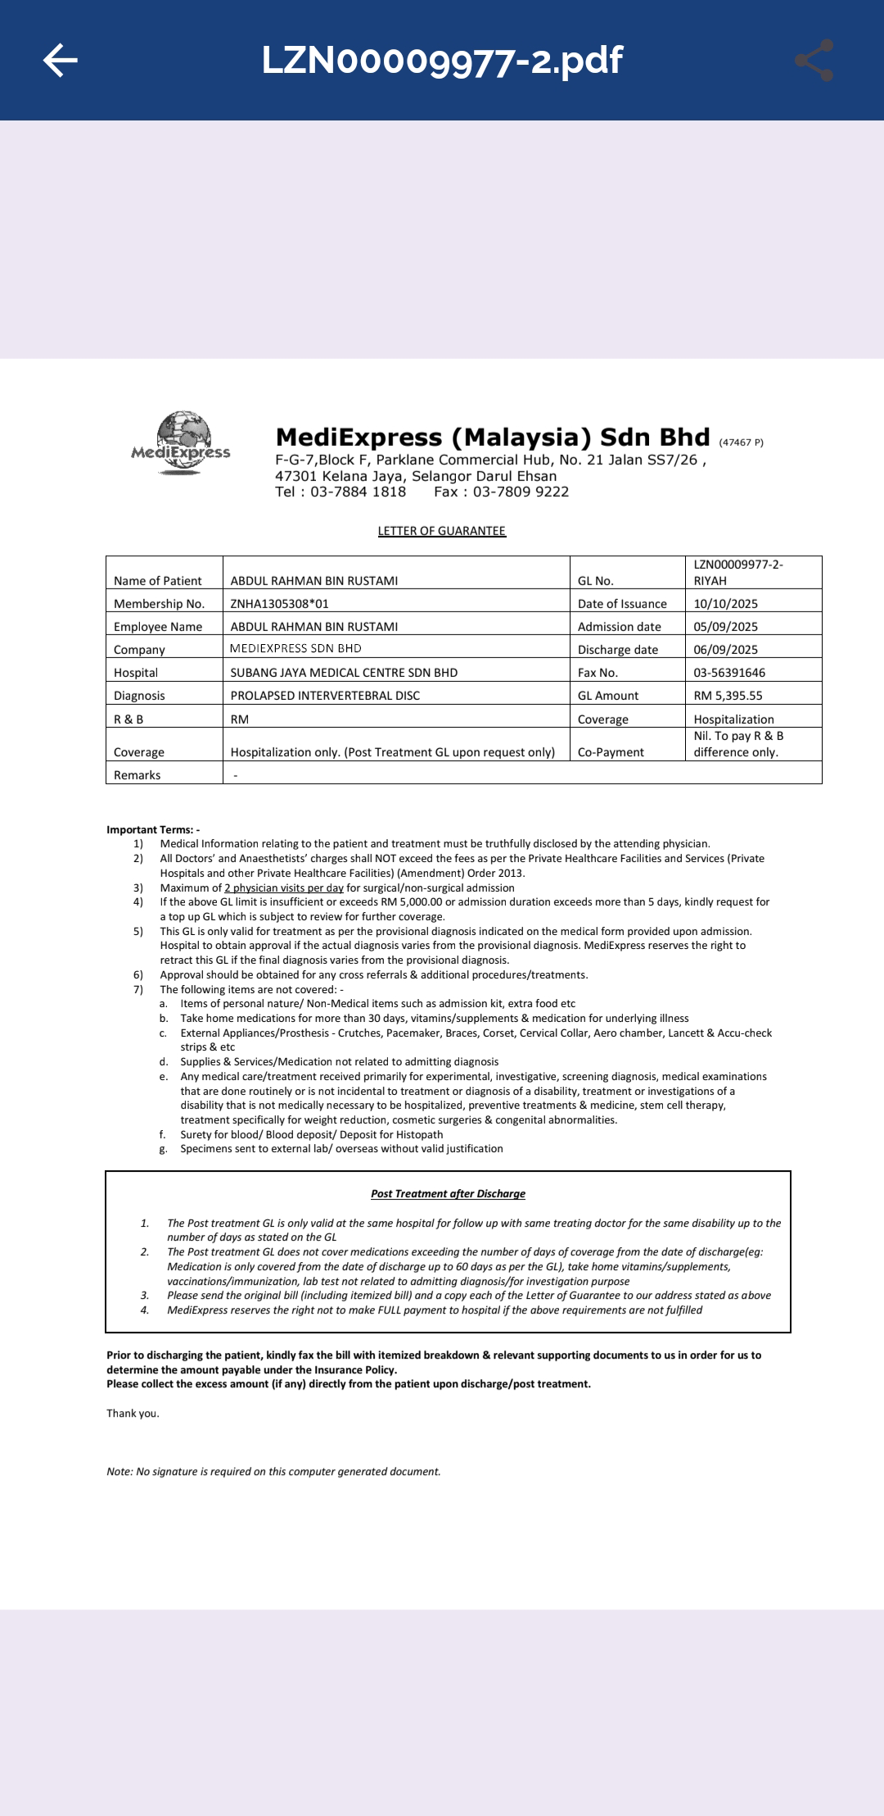
VIEW GUARANTEE LETTER STATUS - INPATIENT
Go to homepage
Tap Guarantee Letter
Select GL type – Inpatient
Status: Requested, In progress or Accepted
Tap More Details
Tap View Guarantee Letter to view the document
Note:
IPGL will only be issued upon request from hospital (with complete documents).
Members will not be able to request Inpatient Guarantee Letter (IPGL) via mobile app.

Slide 18
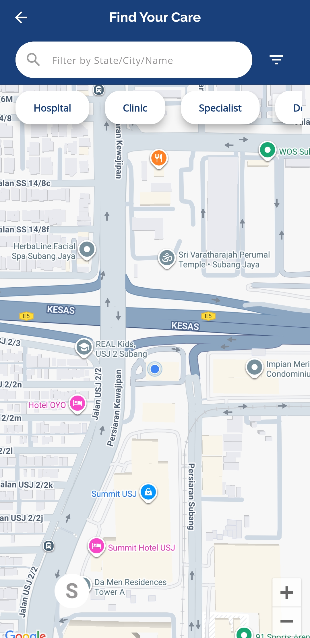
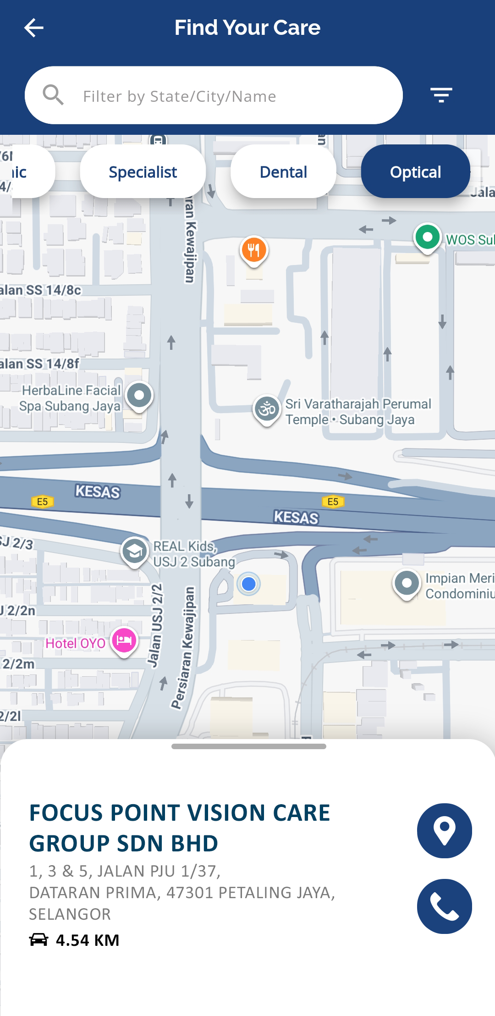
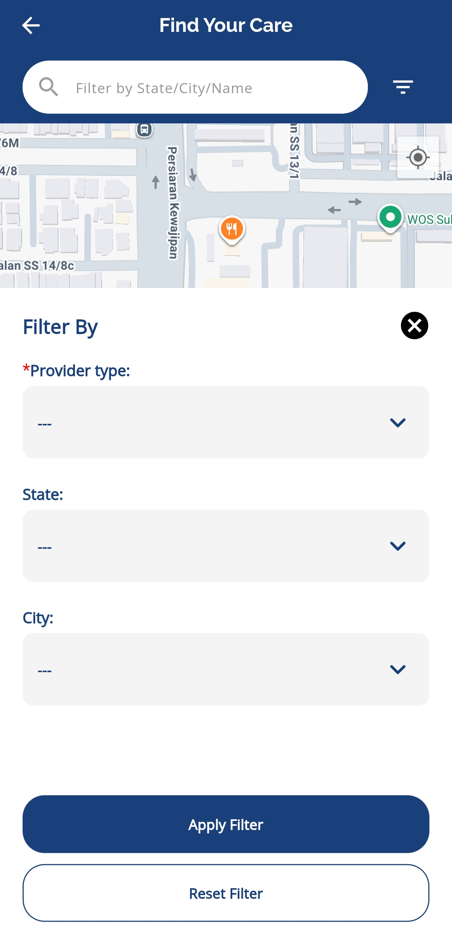
PROVIDER LOCATOR
Go to homepage
Tap Locator
Select each provider type to view the provider list such as Clinic, Hospital, Dental and Optical
Tap provider name to view details
Click the location icon for directions (Waze or Google Maps)
Tap the phone icon to contact the provider
Tap the 3 lines icon in the top right to filter the provider type
Specify the provider in the search field
Click Apply Filter

Slide 19
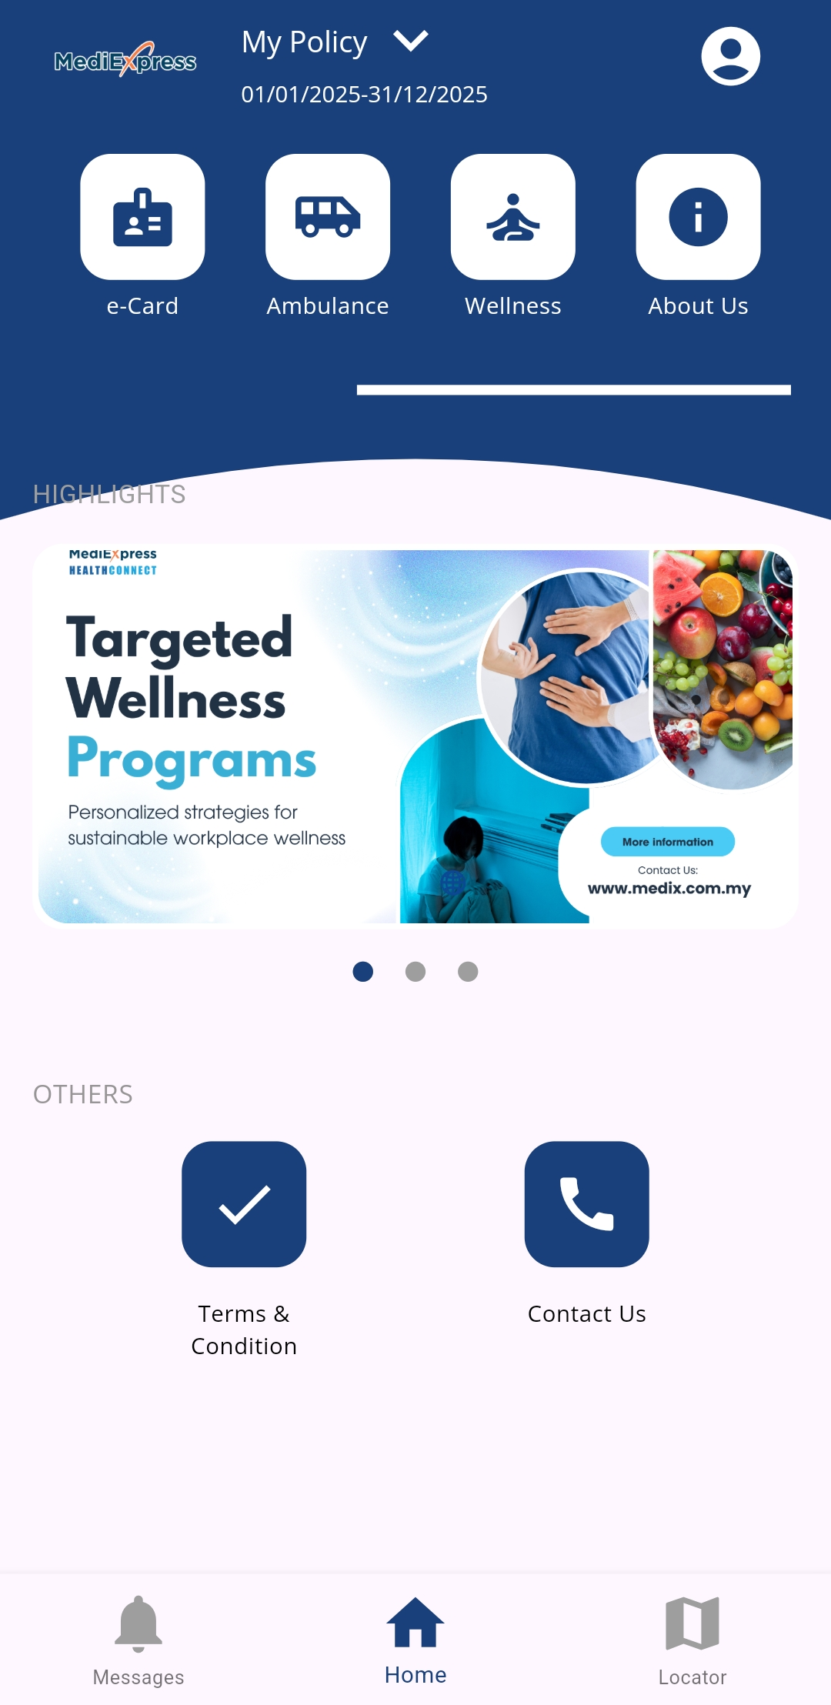
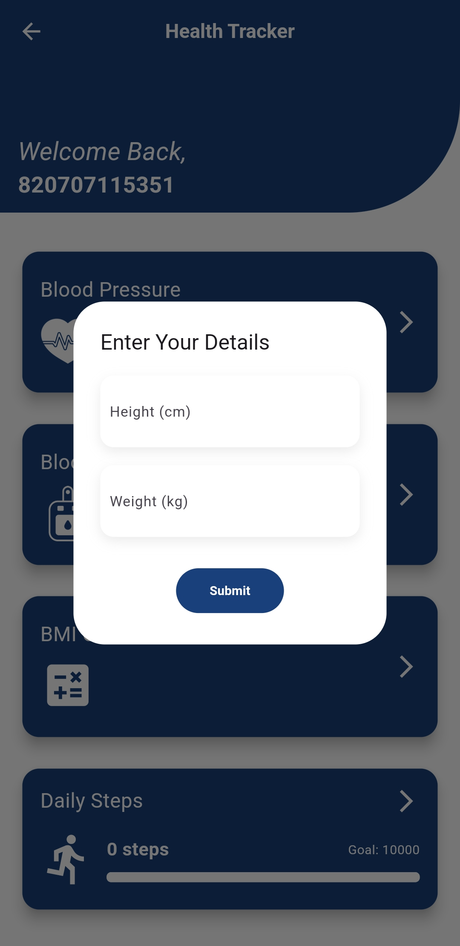
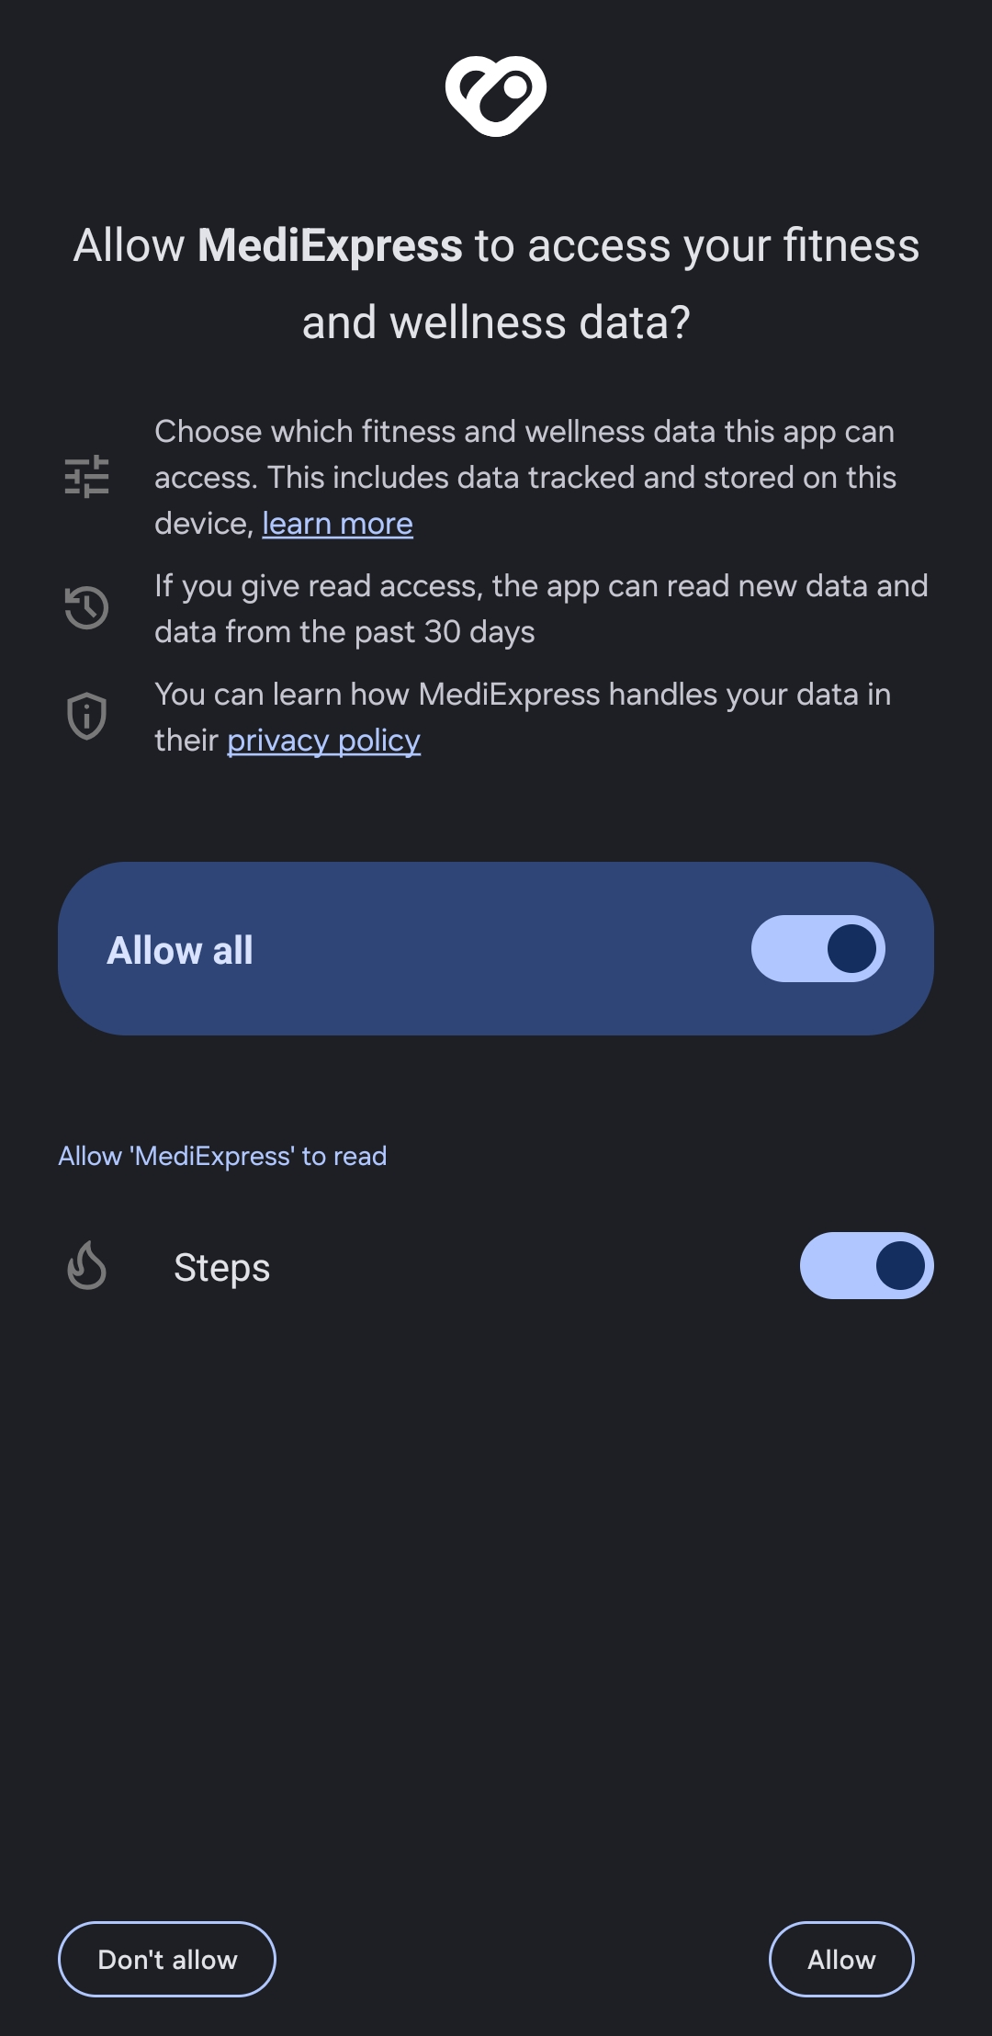
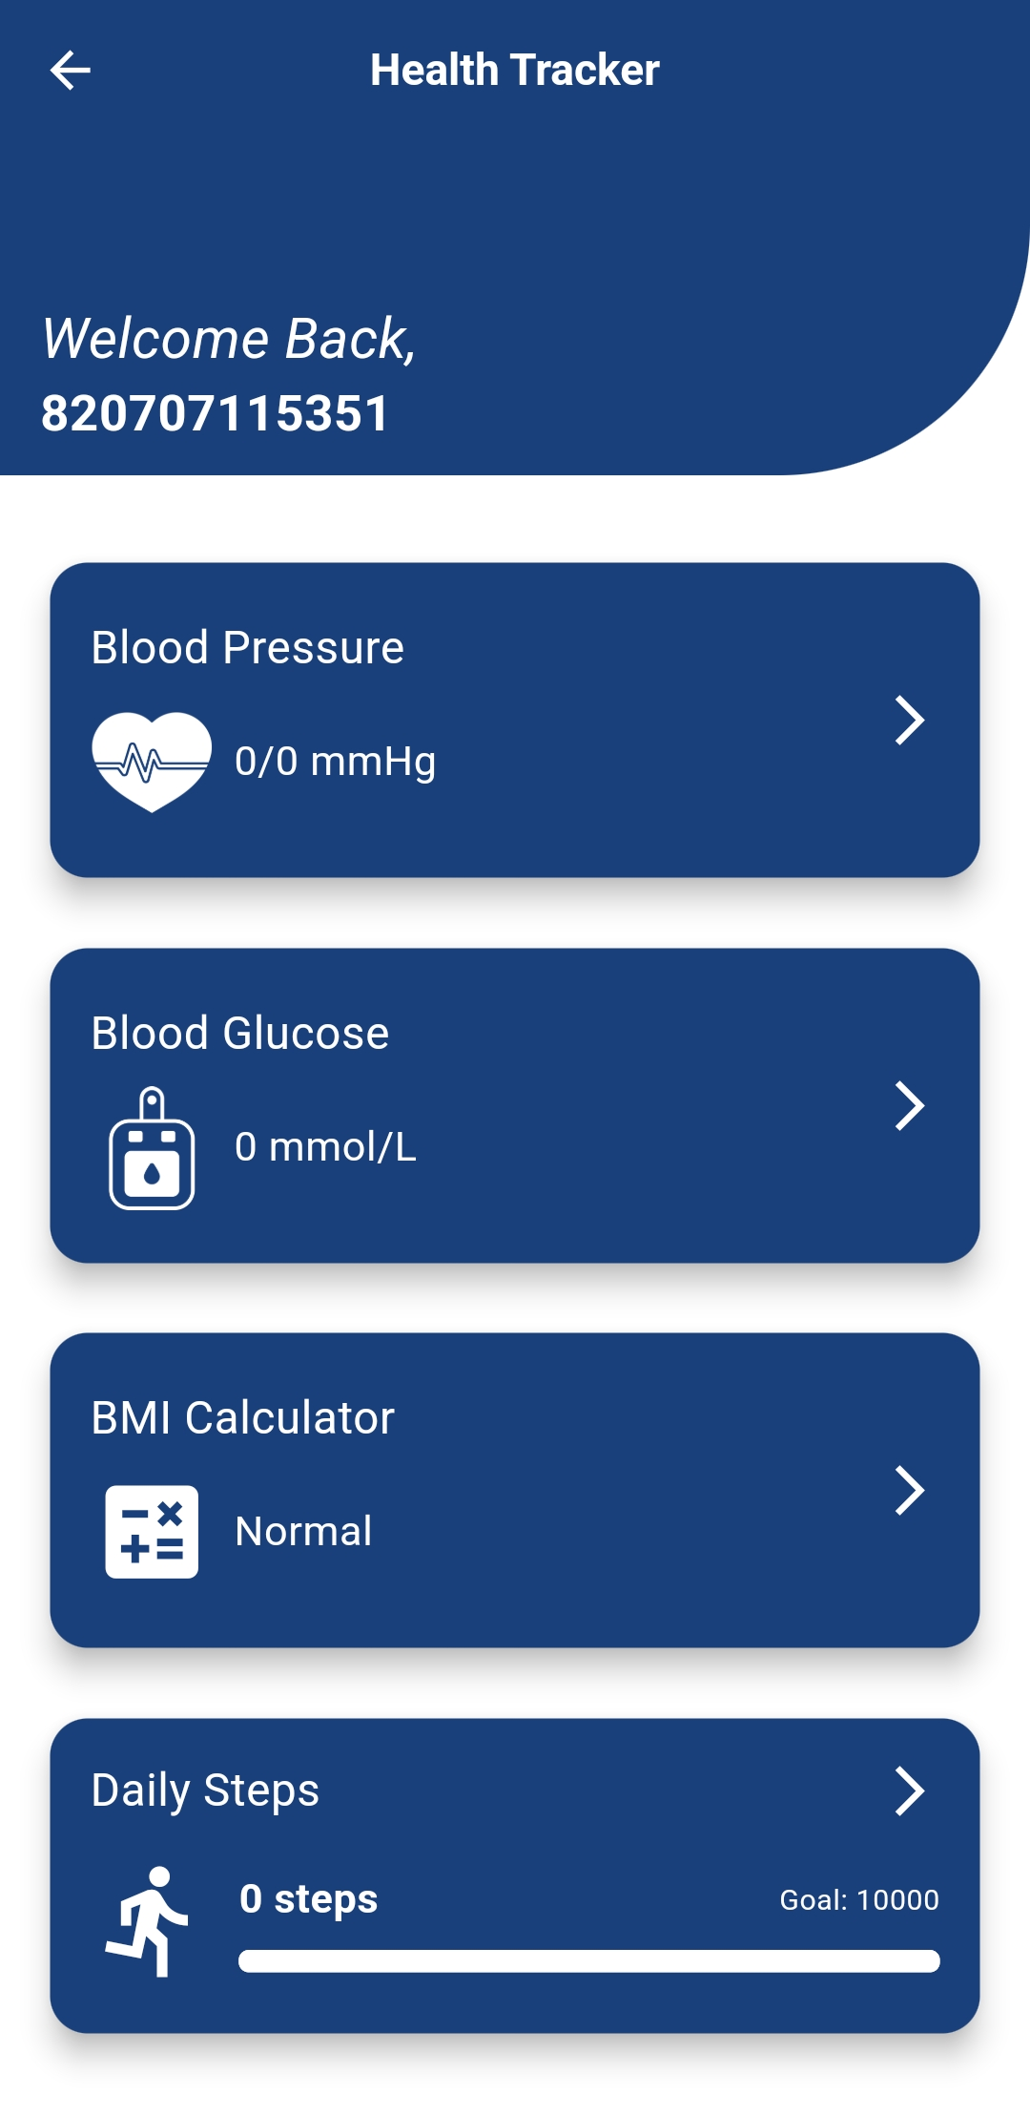
WELLNESS – HEALTH TRACKER
Go to homepage
Tap Wellness
Key in your wellness details: height and weight
Click Allow all to sync your fitness features with the app
Once permission is granted, user can start using the available health tracker

Slide 20
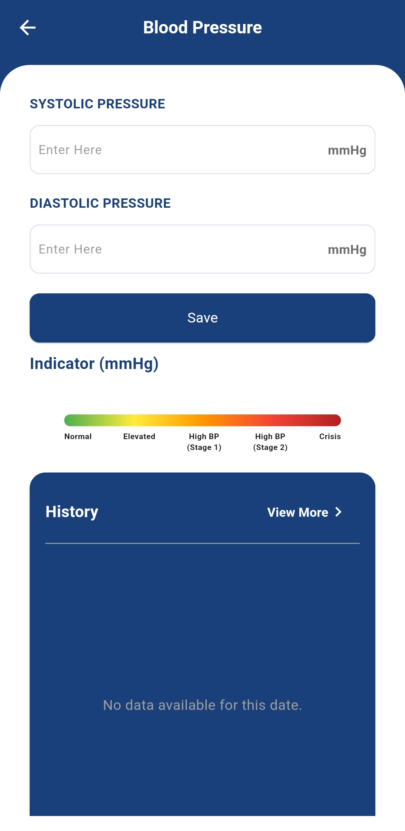
HEALTH TRACKER – BLOOD PRESSURE
Go to homepage
Tap Wellness
Select Blood Pressure
Enter the required info
Click Save
The update will be recorded in the History section
Tap View More in History to edit

Slide 21
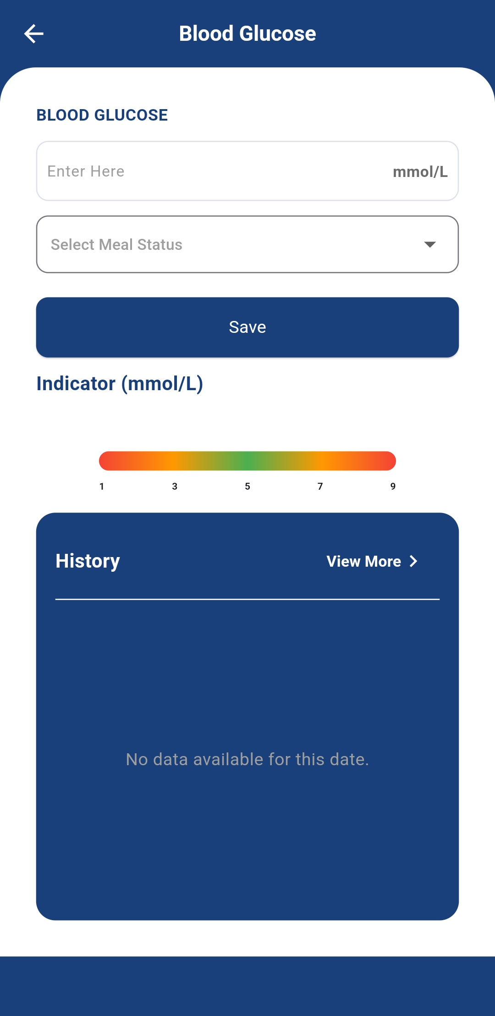
HEALTH TRACKER – BLOOD GLUCOSE
Go to homepage
Tap Wellness
Select Blood Glucose
Enter the required info
Click Save
The update will be recorded in the History section
Tap View More in History to edit

Slide 22
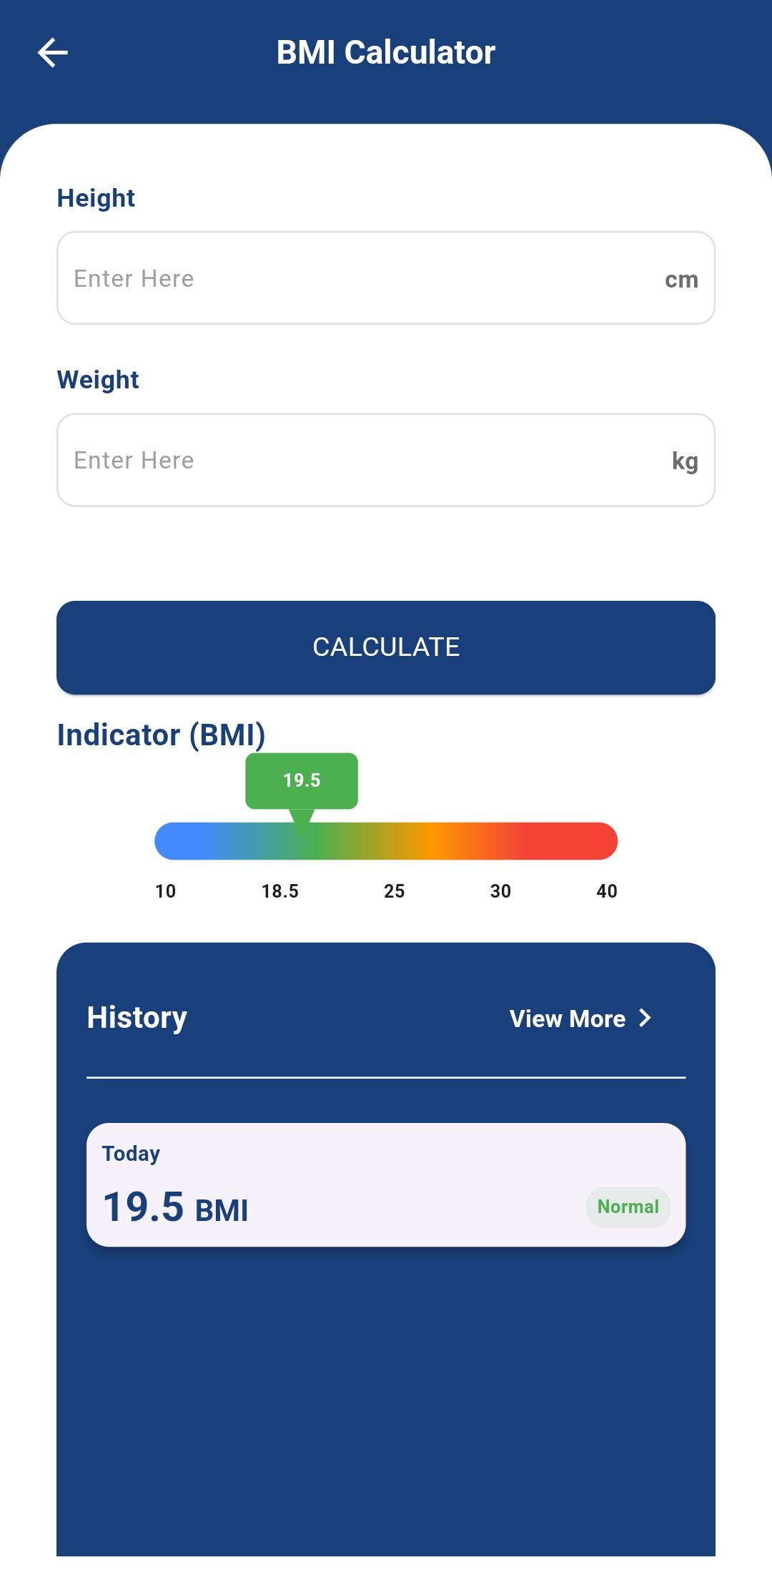
HEALTH TRACKER – BMI CALCULATOR
Go to homepage
Tap Wellness
Select BMI
Enter the required info
Click Save
The update will be recorded in the History section
Tap View More in History to edit

Slide 23
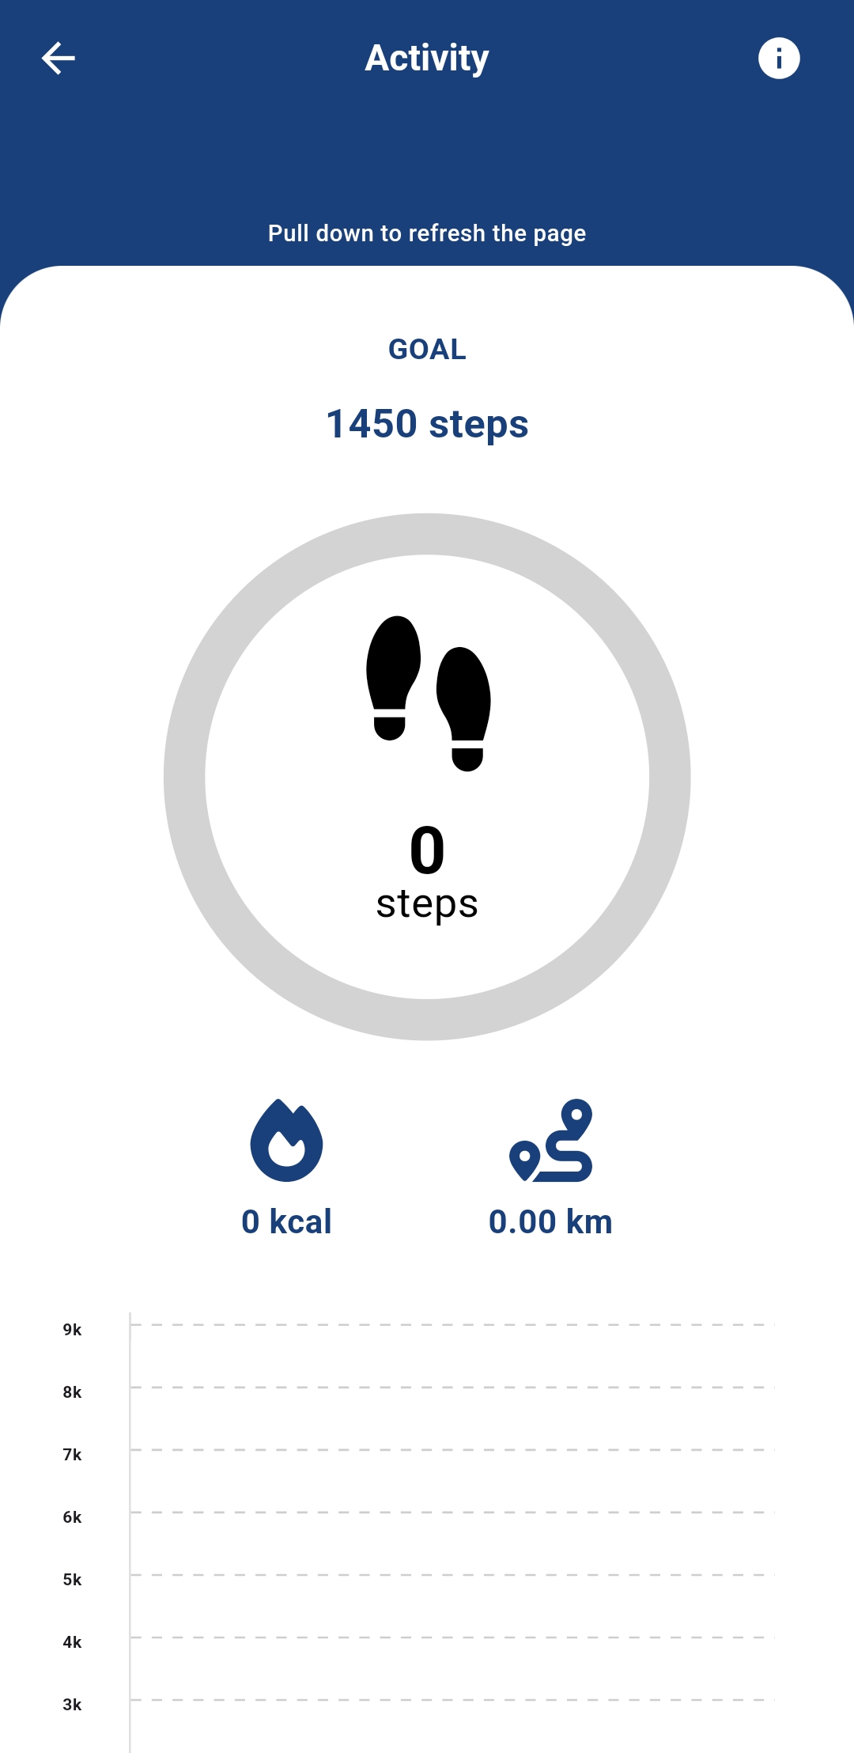
HEALTH TRACKER – DAILY STEPS
Weekly badges for Steps Count based on the goal of 10K steps per day
Badge Tiers:
Bronze – 5K steps/day
Silver – 7K steps/day
Gold – 10K steps/day
Go to homepage
Tap Wellness
Select Daily Steps
Tap activity to track every each of your step

Slide 24




CONTACT US
For further assistance, feel free to reach out to us regarding:
Medical benefits & coverage inquiries
Guarantee Letter (GL) issuance
Panel listing inquiries
Others
Helpline: 1300-80-0020
Email:
Inpatient – adm@medix.com.my
Mobile Support – csu@medix.com.my
Web Portal:
https://m.mediexpress.com.my/login
(Message only)
Inpatient – 011-6301 8182

Slide 25
THANK YOU

